Slide 1
App Based Socio Economic Survey
TILLER
www.tiller-bd.com

Slide 2
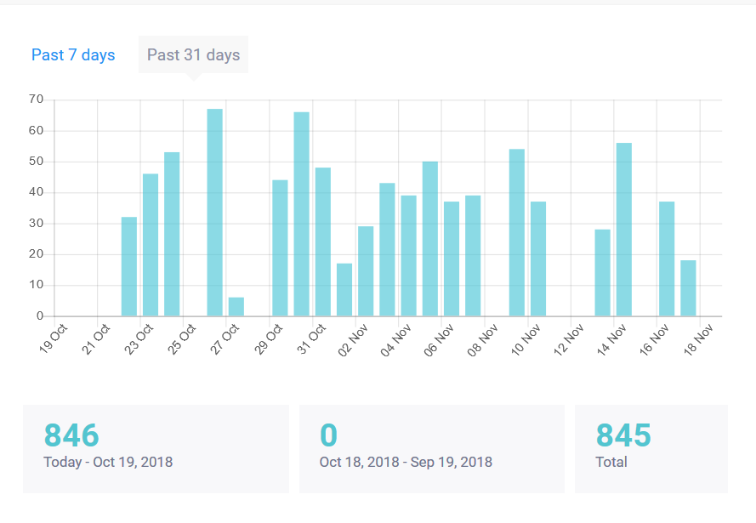
Daily Survey progress - Barguna

Slide 3
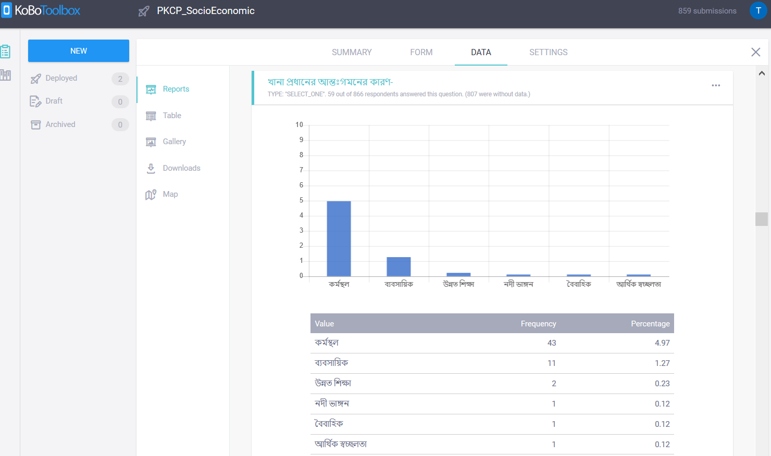
Real Time Report

Slide 4
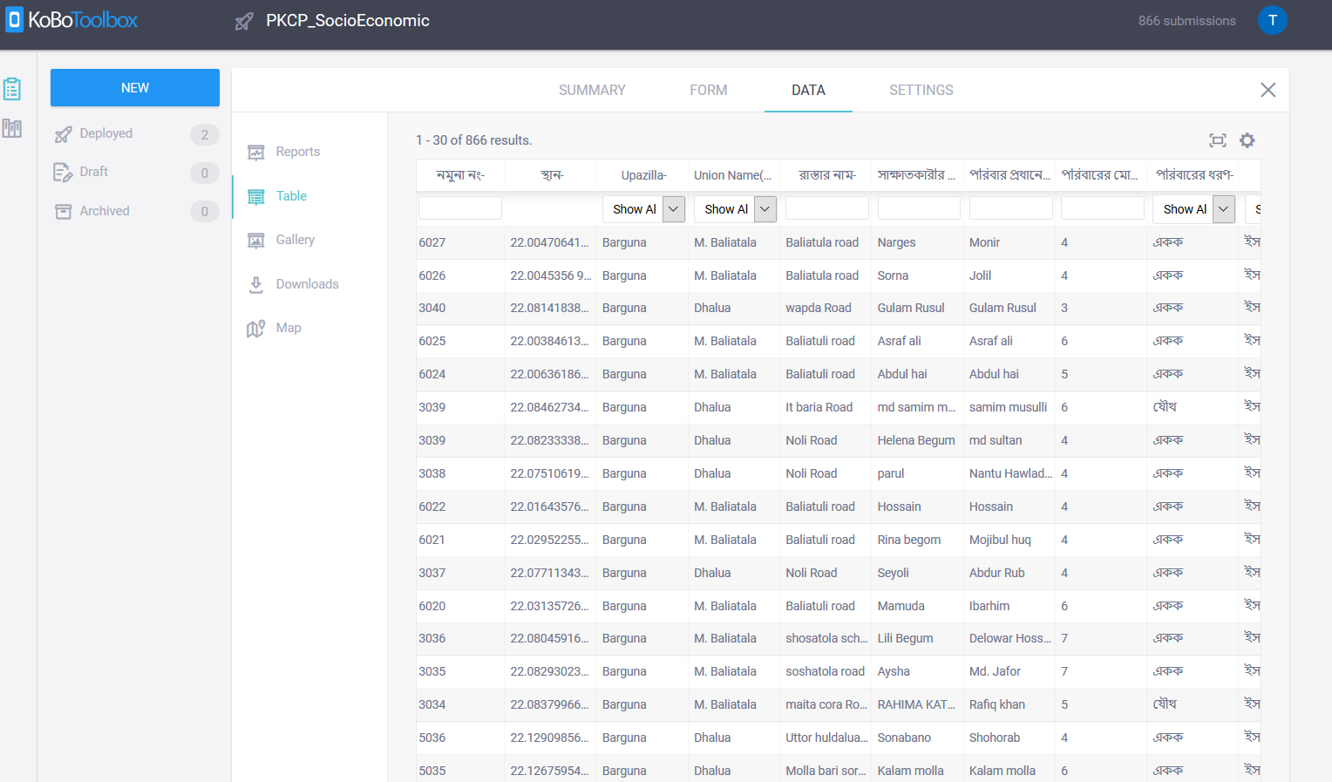
Survey Database

Slide 5
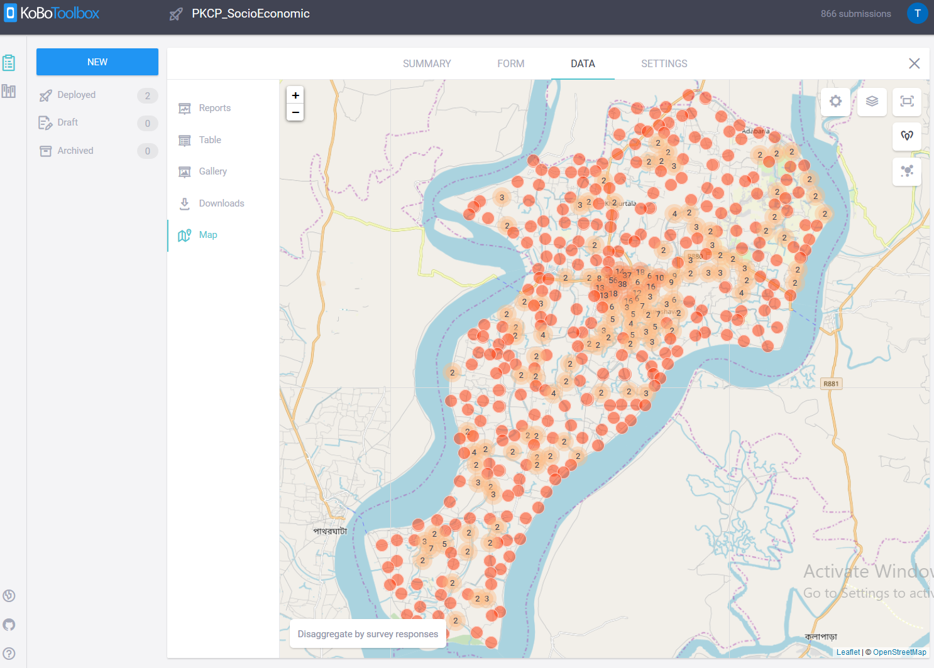
Socio economic Survey Location

Slide 6
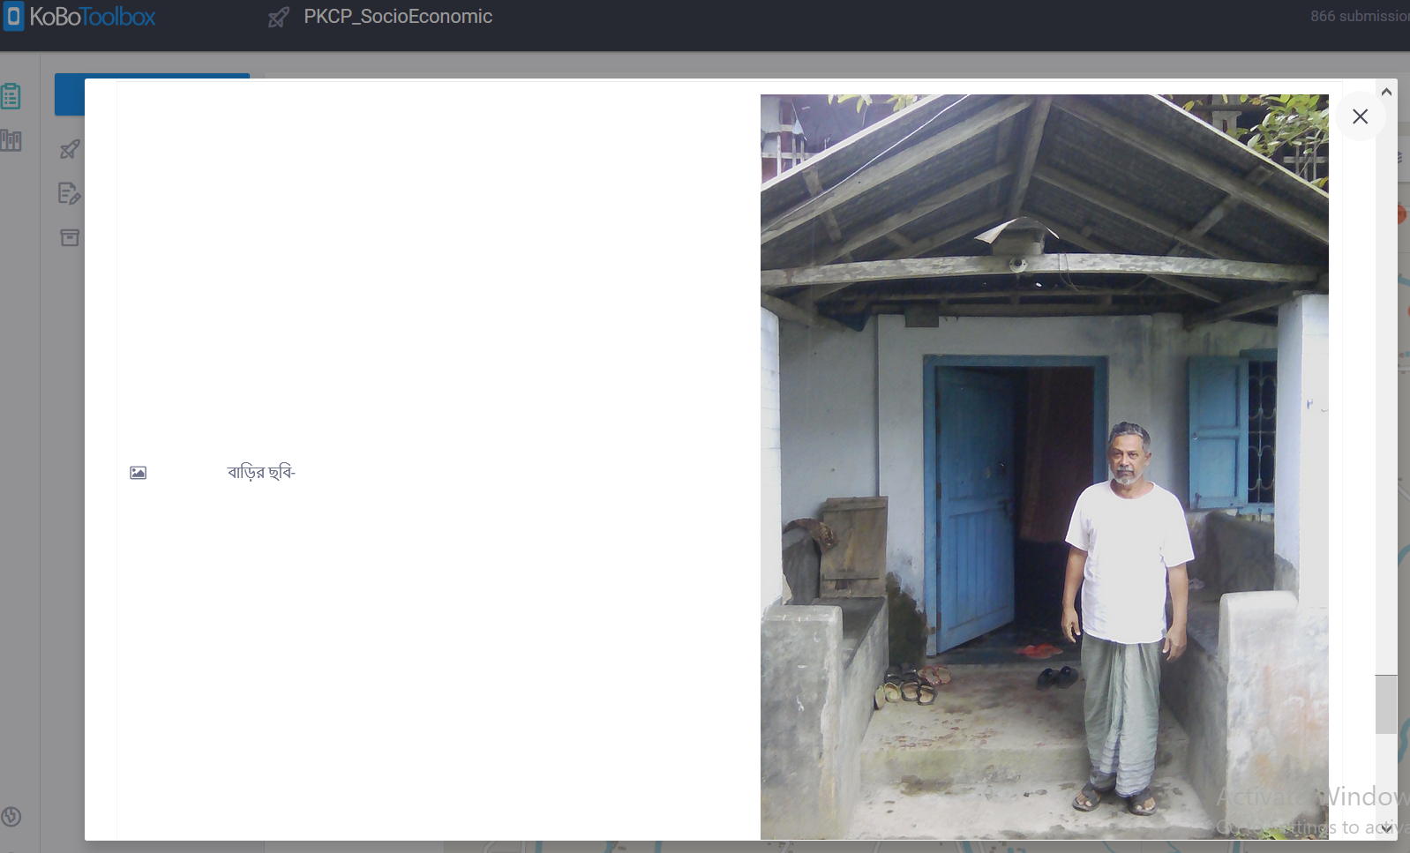
Respondent Photograph in online database

Slide 7
Online database
https://kf.kobotoolbox.org/#/forms/axNQgP4qvnKpWMRrSPbLYU/data/map
Usename:tamzid
Pass:tamzid123

Slide 8
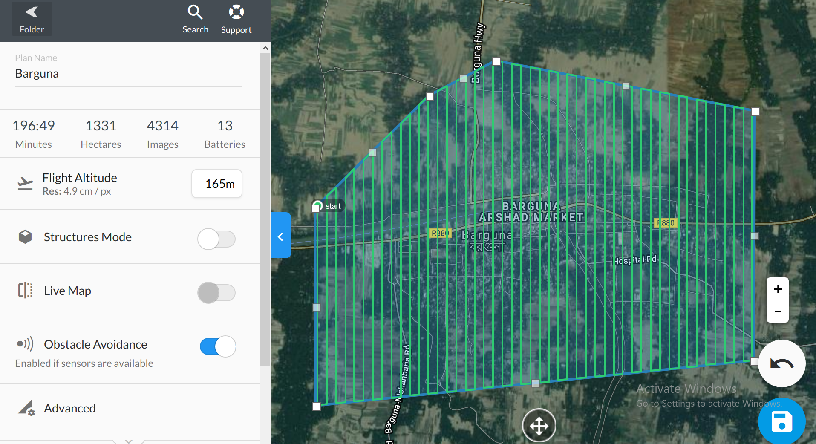
UAV Flight Plan for Barguna

Slide 9
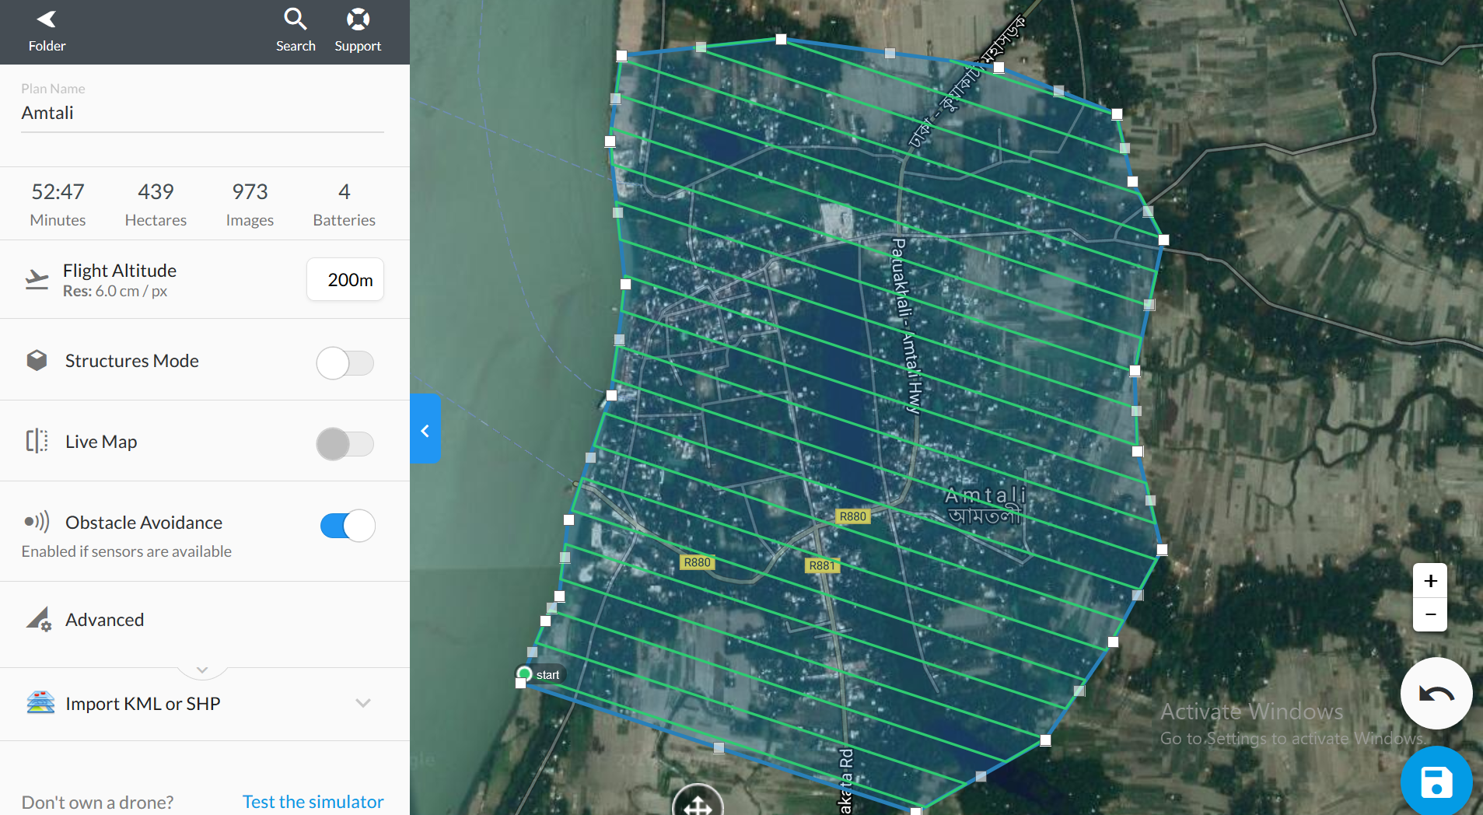
UAV Flight Plan for Amtoli

Slide 10
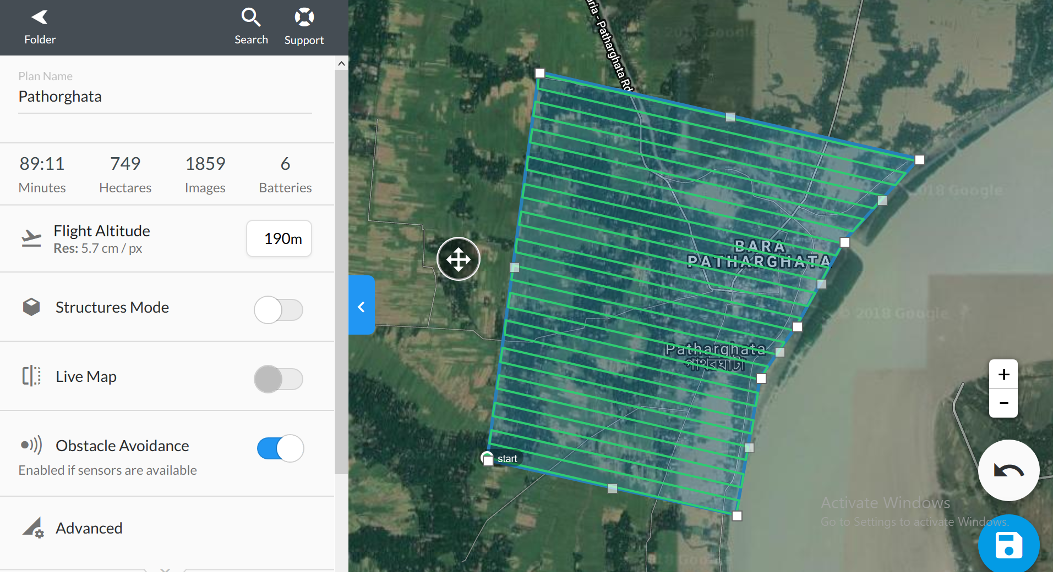
UAV Flight Plan for Pathorghata

