Slide 1
Properties & Section of Steel
Presented by,
Engr. Md. Nazmul Alam
Chief Instructor (Tech/Civil)
Rangpur Polytechnic Institute

Slide 2
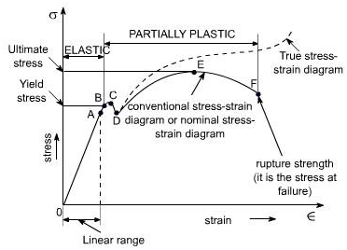
Stress strain diagram of mild steel

Slide 3
Properties of the steel
Strength.
Toughness.
Ductility.
Weldability.
Durability.

Slide 4
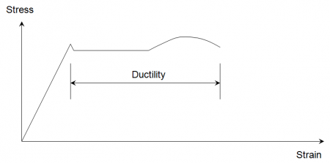
Ductility
Ductility is a measure of the degree to which a material can strain or elongate between the onset of yield and eventual fracture under tensile loading as demonstrated in the figure below.

Slide 5
Toughness
Toughness of steel and its ability to resist brittle fracture
Mechanical properties of steel
Modulus of elasticity, E = 210,000 N/mm²
Shear modulus, G = E/[2(1 + ν)] N/mm², often taken as 81,000 N/mm²
Poisson's ratio, ν = 0.3
Coefficient of thermal expansion, α = 12 x 10-6/°C (in the ambient temperature range).

Slide 6
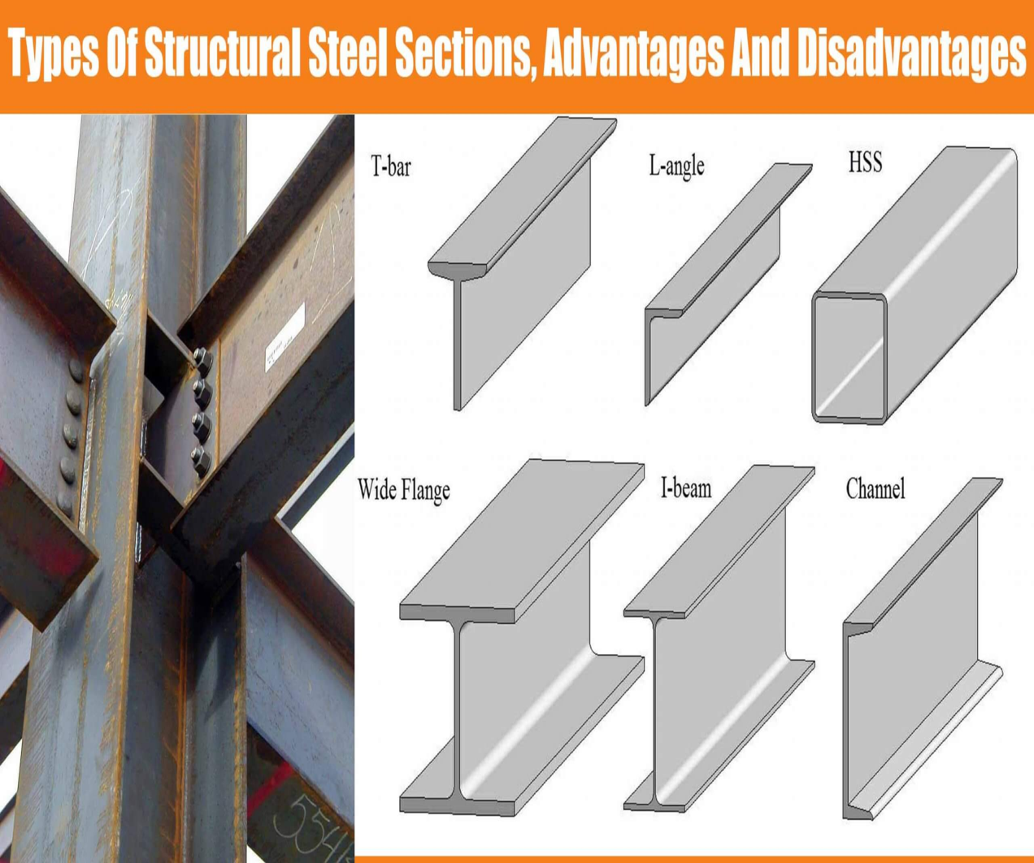
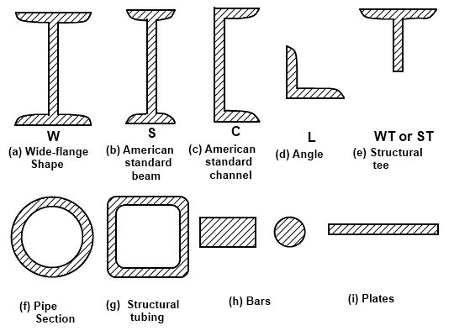
Steel sections

Slide 7
Difference between LRFD and ASD design
ASD checks service load stresses against an allowable stress, whereas LRFD uses factored load forces against a maximum strength LRFD. ASD is the more traditional method and has been in use for many years.
LRFD will result in stronger structures for more highly dynamic loads and ASD will result in stronger structures for less variable (more predicable) loads

Slide 8
Thanking
You

