Slide 1
Strength Of Materials
MD. SAIDUL ISLAM
Instructor(Mechanical)
Sub code-27061
Class-01

Slide 2
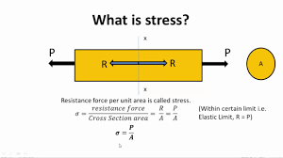
Stresses induced in machine elements & causes of failure
Stress
Stress is the a measure of what the material feels from externally applied forces. It is simply a ratio of the external forces to the cross sectional area of the material.

Slide 3
Tensile stress
Tensile stress is defined as the force per unit area induced in the body in response to externally applied force, which tends to elongate or stretch the body.
Compressive stress
Compressive stress is a force that causes a material to deform to occupy a smaller volume. When a material is experiencing a compressive stress, it is said to be under compression. A high amount of compressive stress, such as tensile stress, leads to failure due to tension.Oct 17, 2019

Slide 4
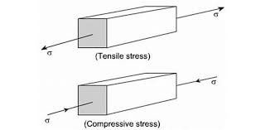

Slide 5
Shear stress
Shear stress, often denoted by τ (Greek: tau), is the component of stress coplanar with a material cross section. It arises from the shear force, ...

Slide 6
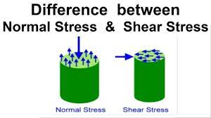

Slide 7
Stresses induced in machine elements & causes of failure
Working stress
Working stress is a stress to which materials may be safely subjected in the course of ordinary used. ... Working stress is also called as allowable stress, permissible stress, safe stress and actual stress. Working stress is always small ultimate tensile stress or yield stress.

Slide 8
Stresses induced in machine elements & causes of failure
Factor of safety
The ratio of a structure's absolute strength (structural capability) to actual applied load
FOS= maximum stress/working stress

Slide 9
Stresses induced in machine elements & causes of failure
Allowable Stress/Design stress
Allowable stress, or allowable strength, is the maximum stress that can be safely applied to a structure.

Slide 10
Stresses induced in machine elements & causes of failure
Thermal stress
In mechanics and thermodynamics, thermal stress is mechanical stress created by any change in temperature of a material. ... In general, the greater the temperature change, the higher the level of stress that can occur. Thermal shock can result from a rapid change in temperature, resulting in cracking or shattering.

Slide 11
Stresses induced in machine elements & causes of failure
Impact stress
Impact stresses are mechanical/dynamic stresses, which are caused by acceleration or deceleration of masses, and, though not generally repeated at regular intervals, do occur more or less frequently and with varying intensity during transport, handling and storage operations.

Slide 12
Stresses induced in machine elements & causes of failure
Bending stress
Bending stress is the normal stress that an object encounters when it is subjected to a large load at a particular point that causes the object to bend and become fatigued. Bending stress occurs when operating industrial equipment and in concrete and metallic structures when they are subjected to a tensile load.

Slide 13
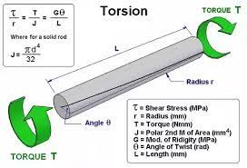
Stresses induced in machine elements & causes of failure
Torsional shear stress Torsional shear stress or Torsional stress is the shear stress produced in the shaft due to the twisting. This twisting in the shaft is caused by the couple acting on it.May 6, 2018

Slide 14
Stresses induced in machine elements & causes of failure
Stress concentration
A stress concentration, also known as a stress riser/raiser, is a point in a part where the stress is significantly greater than its surrounding area. Stress concentrations occur as a result of irregularities in the geometry or within the material of a component structure that cause an interruption of the stress flow.Aug 21, 2020

Slide 16
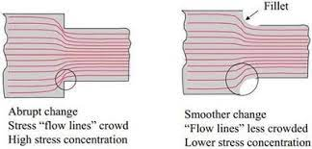
Stresses induced in machine elements & causes of failure

Slide 17
THANK YOU

