Slide 1
Introduction of Steel Structure
Presented by
Engr. M M Shahjahan Islam
Instructor (Tech/Civil)
Rangpur Polytechnic Institute, Rangpur

Slide 2
What is steel structure?
Steel structure is a metal structure which is made of structural steel components connect with each other to carry loads and provide full rigidity.

Slide 3
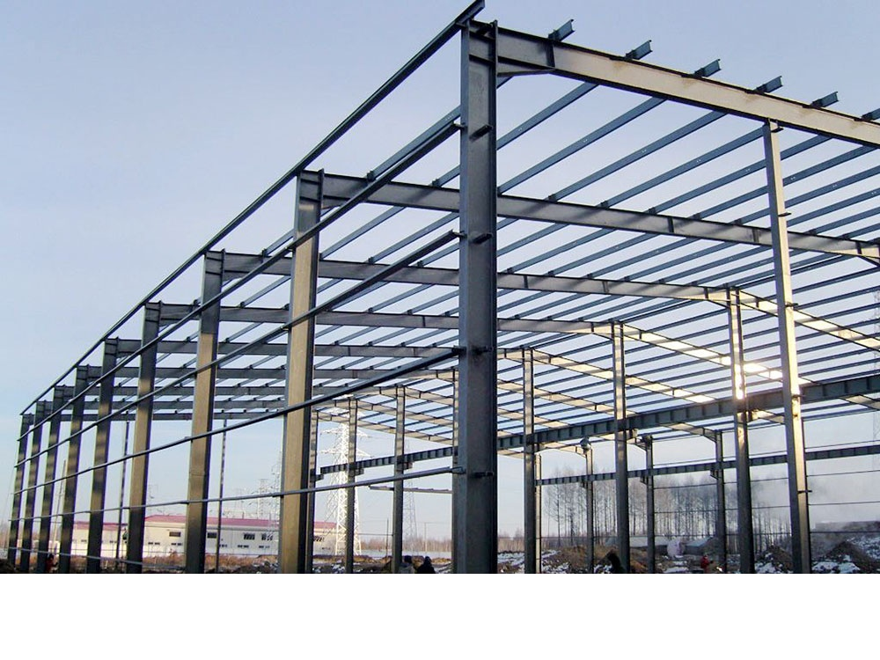
Common Types of Steel Structures
Steel frame structures
These are the most common type of steel structures and are used in a wide range of buildings, from high-rise offices to residential homes.

Slide 4
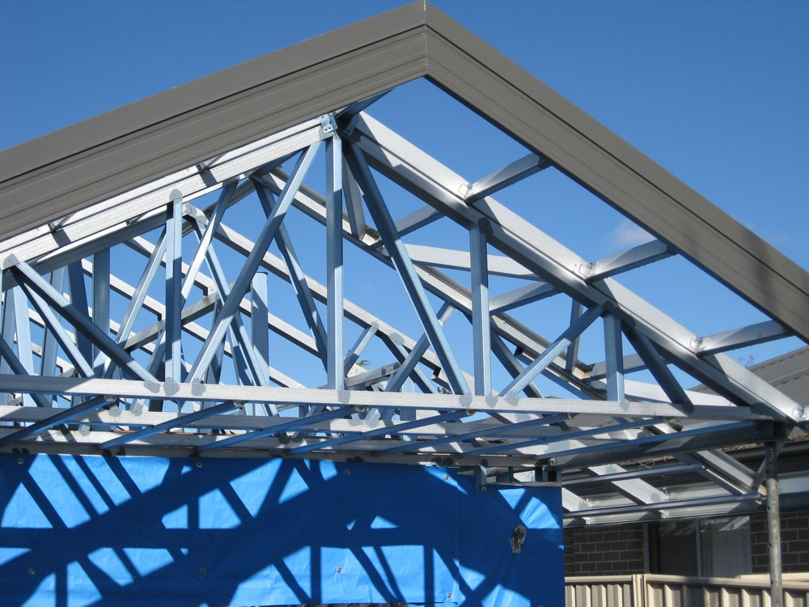
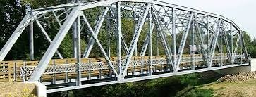
Steel Truss
Steel truss structures are a type of construction method that uses a series of interconnected triangles to distribute weight evenly across the structure. Steel truss structures are commonly used for roofs and bridges, but can also be used for other applications where long spans are required.

Slide 5
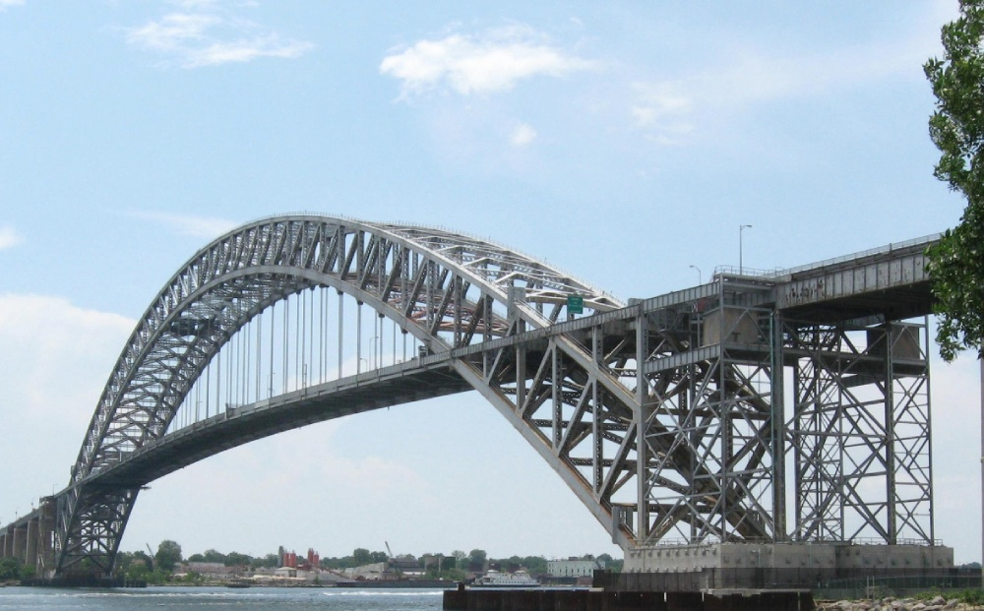
Steel arch structures
These structures are used for bridges and buildings where a long span is required. The steel arch structure consists of a curved steel arch that supports the weight of the structure. The arch is made up of a series of connected steel members that form a curved shape.

Slide 6

Steel Cable Structures
Steel cable structures are a type of construction method that uses steel cables to support the weight of the structure, creating a suspension system. They are commonly used for suspension bridges and roofs.

Slide 7

Suspension Bridge
A suspension bridge is designed to carry road and rail traffic, often over great distances in a single span, to connect communities. The roadway is suspended from two long cables that straddle the towers.

Slide 8
Key Components of Steel Structures
Steel Beams
Steel Columns
Steel Trusses
Connectors and Fasteners

Slide 9
Advantages of Steel Structures
Durability and Strength
Flexibility and Adaptability
Cost-Effective
Eco-Friendly
Speed of Construction

Slide 10
Disadvantages of Steel Structures
Corrosion
Fire Resistance
Cost
maintenance costs

Slide 11
Difference between Steel structure vs RCC structure
RC Structures Steel Structures
The basic material used is reinforced cement concrete to take up the load Steel is the material used to take the load
In RC structures, the cross-section of the structural elements is large steel structures have small cross- sections.
RC structures are highly brittle in nature. Steel structures are ductile in nature
RC structures have low load-carrying capacity compared. having appreciable load-carrying capacity.
possesses huge dead weight The steel, in general, has 60 percent less weight
Steel structures do not demand heavy foundation. Demands a strong foundation to support.
In RC structures, the tensile strength of the concrete elements is less have high tensile strength compared to RC
Construction of RC structure is simple. Construction of steel structure is tough.
Economical Costly
Reinforced concrete structures is a slow process. Steel structures are constructed with high speed.
It is tough to maintain quality through concrete construction. Better quality control can be obtained in steel structures.
The fire resistance of the concrete structure is high. The fire resistance of steel structure is less.
Concrete does not have any scrap value. The steel scraps have a good scrap value.
The repair and cost of maintenance tough and time taking. Their cost of maintenance is less.

Slide 12
Thanking
You

