Slide 1
Welcome
to
Nihar Ranjan Mohanta Junior Instructor Power Technology Rangpur polytechnic Institute, Rangpur

Slide 2
Power Technology
4th semester
Power Engineering Fundamental
Sub. code | T | P | C | T.C | T.F | P.C | P.F | TOTAL
27111 | 2 | 6 | 4 | 40 | 60 | 50 | 50 | 200

Slide 3
Previous slide contain
What is hazard
What is safety
Hazard may loss
Classification of Safety
Classification of Hazard
List the personal protective equipment (PPE)
List the Eye, feet, face & Respiratory PE
Cause of industry accident
Risk management process
Difference between risk and hazard

Slide 4
This slide contain
Define Automobile
Parts name of automobiles car
Classify of automobile
Basis of manufacturing company
Basis of shape
Basis of engine nature
passenger or goods
Basis of wheel and axel
Some vehicle name
Automobile field & industry in BD

Slide 5
Define Automobile
An automobile is a usually four wheeled vehicle designed primarily for passenger or goods or accessories transportation and commonly propelled by an internal combustion engine using a volatile fuel .

Slide 6
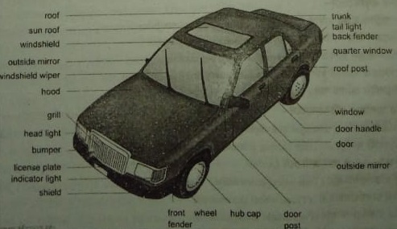
Modern automobiles car

Slide 7
Parts name of an modern automobiles car
Roof
Sun roof
Windshield
Outside mirror
Windshield wiper
Hood
Grill
Head light

Slide 8
Parts name of an modern automobiles car
Bumper
License plate
Indicator light
Shield
Trunk
Tail light
Back fender
Quarter window

Slide 9
Parts name of an modern automobiles car
Roof post
Window
Door handle
Door
Outside mirror
Door post
Hub cap
Wheel
Front

Slide 10
Classify of automobile
On the basis of shape
Motor cycle
Car
Jeep
Microbus
Minibus
Bus
Truck and lorries
Tractor

Slide 11
Classify of automobile
On the basis of engine nature
Petrol engine
Diesel engine
Gas engine
Storage battery
Turbine drive

Slide 12
Classify of automobile
Basis of passenger or goods
Passenger automobile
Container caring automobile
Basis of wheels and axle
Two wheel automobile
Three wheel automobile
Four wheel automobile
Six axle and ten axle automobile

Slide 13
Classify of automobile
Basis of manufacturing company
Progoti
Tata
Toyota
Ford
Mazda
Mercides benz
Mitsubishi

Slide 14
Classify of automobile
Basis of manufacturing company
Maruti
Land cruser
Volks wagon

Slide 15
Some vehicle are
Motors-cycle
Car
Jeep
Microbus
Minibus
Bus
Track and lorries
Tractor

Slide 16
Automobile field & industry in BD
Agriculture
Power plant
Industry
As a vessel
As a land vehicle
As an aircraft
Othesr
mixture machine
Buldozer
Road roller

Slide 17
Overview
Define Automobile
Parts name of automobiles car
Classify of automobile
Basis of manufacturing company
Basis of shape
Basis of engine nature
passenger or goods
Basis of wheel and axel
Some vehicle name
Automobile field & industry in BD

Slide 18
Next class
Define engine
Type engine basis of combustion
Parts name of petrol engine
Fixed parts name of petrol engine
Movable parts name of petrol engine

Slide 19
Thanks

