Slide 1
Draft
RESEARCH REPORT
Date: 07 June, 2023
Dr. Mohammad Ekramol Islam Professor and Treasurer Northern University Bangladesh Email: meislam2008@gmail.com +8801741665635 | Dr. Muhammad Mofizur Rahman Assistant Professor, ID 15084 Directorate of Secondary and Higher Education Bangladesh, Dhaka Email: mmr015084@gmail.com +8801711045100
1

Slide 2
Factors Related To E-learning Adoption In Higher Education: Bangladesh Perspective
1

Slide 3
Introduction
In the modernization of socio-economies, technology has played a key role in higher education in economic development (Baliamoune-Lutz, 2003; Chacko, 2005; Kottemann & Boyer-Wright, 2009; Unwin, 2019).
Today, educational institutes are attempting to grow their effect among learners with the objective that they can pick up progressively essential advantages (Al-Shihi et al., 2018; Han KimSen et al., 2001; Roohullah et al., 2016).
The adoption of technological devices and its' impact on education improved efﬁciency to the accessibility of education to the educational communities in the last decade of the knowledge economy.
….. CONT

Slide 4
Introduction
E-learning is a key element in the university, but the way of reporting E-learning to the student is essential (Brammer, 2008) and (H. Hamidi & Chavoshi, 2018).
Educators faces issues and difficulties in using technology upgraded instructing because they have constrained information and come up short on the information, experience, and abilities to harmonize mobile learning innovation into their education (Abdullah et al., 2012; Azrina et al., 2014).
…..CONT

Slide 5
Introduction
Most of the country, the teachers do not integrate technology effectively into their curriculum (Zidoun et al. 2019).
Developed countries considered e-learning an effective tool, but with few exception, it is not used properly in developing or least developing countries like Bangladesh (B Biswas et al., 2020).
Bangladesh is one of the fastest countries of mobile spreading globally (B Biswas et al., 2020).
…..CONT

Slide 6

Background of study
Bangladesh is one of the quickest mobile entrance nations in the world (Chowdhury, 2015).
Wikipedia
Position of Using Smartphones
18th 2020
19th 2019
46th 2018
11th 2021
50th 2017
…..CONT

Slide 7
Background of study
As the report of the Dhaka Tribune (May 25, 2021) Everyone has a mobile connection in Bangladesh now.
Most of the smart phone clients in Bangladesh are in the age of 18 to 25 (I. Khan, 2013).
Mobile Phone > People
At the end of 2022, there were 181.02 million active mobile subscribers for 165.5 million peoples.
Mobile phone endorsers 183.8 million,
Internet subscribers were 126.1 million.
April 2023 (BTRC)
…..CONT

Slide 8
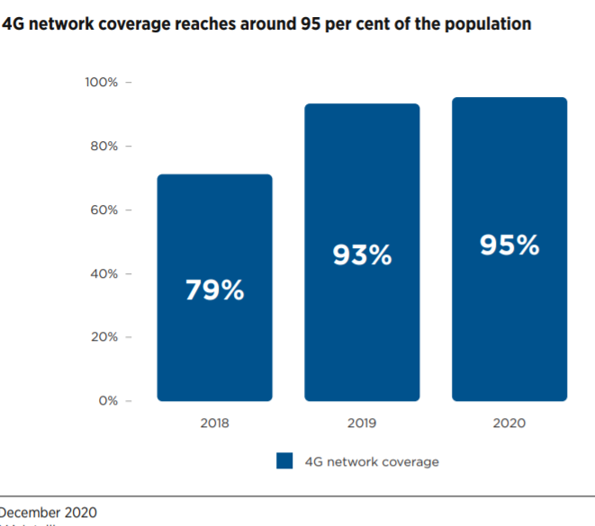
Background of study
December 2020
Source: GSMA Intelligence

Slide 9
Rational of the study
Most of university students use smartphones in Bangladesh, but only 23.7% use for education (Hossain, 2014).
Several educators have already on track to participate in online classes, but they have the foggiest idea on it (B Biswas et al., 2020).
…..CONT

Slide 10

Research objectives
To investigate ‘the stakeholders’ attitude towards e-learning adoption in higher education (university level).
To identify the most influential factors for E-learning Adoption in Bangladesh

Slide 11

Research QUESTIONS
What are the factors of E-learning adoption in Bangladesh?
How the region/area moderates the E-learning adoption in higher education in Bangladesh?

Slide 12
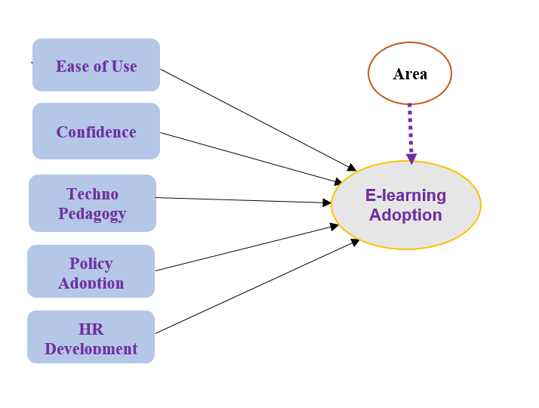
Conceptual Model

Slide 13
Research methodology refers to how the study systematically designs to ensure valid and reliable outcomes that statement the study aims and objectives (Jansen & Warren, 2020).
Research methodology
… CONT

Slide 14
Research DESIGN
Quantitative research
A quantitative approach tests the hypotheses and measures the problems, the effect of the intervention or predicts the association to exposure variables related to the outcome (Rehman, 2021).
Numerous past analysts have utilized the survey questionnaire technique to research M-learning acceptance and utilization (Al-Harbi, 2011; Moukali, 2012; K. Rapeepisarn, 2012; Robinson, 2009).
… CONT

Slide 15
Research DESIGN
Pilot Survey
Face to Face Interview
Survey questionnaire
Secondary Source
Primary Source
Quantitative
Primary source | Secondary source
Online questionnaire | Published articles & Newspaper
Face to face interview | Reports from different sources
Focus group discussion | Different Websites
Sources of data
… CONT

Slide 16
Research DESIGN
Data Analysis Tools
Statistical Package for Social Sciences (SPSS)
V-25
SmartPLS
V-3.2.8
SPSS statistical software could easily perform the Pearson's Correlation or Spearman's Rank Correlation tests for examining the bivariate relationship between targeted variables
(Mohd Hanafi Azman Ong & Puteh, 2017)
The exploration underneath thinks about focuses to make a current hypothesis, PLS-SEM is the most astounding decision
(Alshurideh et al., 2020)

Slide 17
Research DESIGN
Data Analysis Tools
Statistical Package for Social Sciences (SPSS)
V-25
SmartPLS
V-3.2.8
Descriptive Analysis
Model assessment
&
Hypothesis testing
… CONT

Slide 18
Data ANALYSIS (Descriptive)
N= 513 (Teachers = 306, Students = 207)
 | Teachers |  | Students |  | Both
 | Frequency | Percent | Frequency | Percent | Frequency | Percent
Female | 64 | 20.9 | 59 | 28.5 | 123 | 24.0
Male | 242 | 79.1 | 148 | 71.5 | 390 | 76.0
Total | 306 | 100.0 | 207 | 100.0 | 513 | 100.0

Slide 19
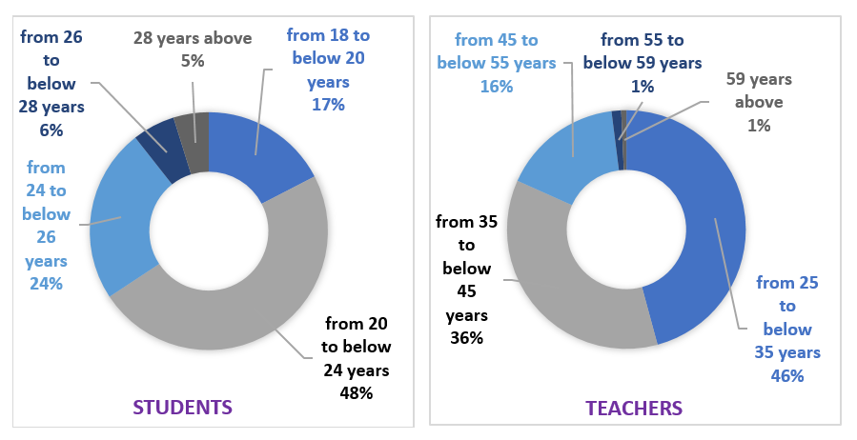
Data ANALYSIS
N= 513 (Teachers = 306, Students = 207)

Slide 20

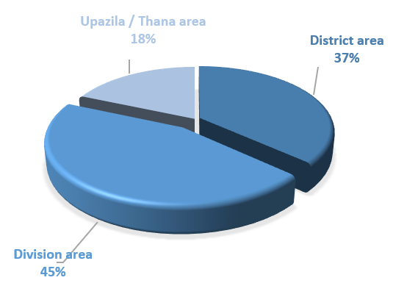
Data ANALYSIS
N= 513 (Teachers = 306, Students = 207)

Slide 21
Data ANALYSIS
Availability of E-learning Technology in College and its Condition
(smartphone, desktop, laptop, internet, etc.)
 |  | Teachers |  | Students
 |  | Frequency | Percent | Frequency | Percent
Availability of E-learning Technology in College | Yes | 234 | 76.5 | 171 | 82.6
 | No | 72 | 23.5 | 36 | 17.4
 | Total | 306 | 100.0 | 207 | 100.0
 | Did not reply | 00 | 00 | 00 | 00
Available technologies are in good condition | Yes | 170 | 71.43 | 134 | 74.44
 | No | 68 | 28.57 | 46 | 25.56
 | Total | 238 | 100.00 | 180 | 100.00
 | Did not reply | 68 | 23.53 | 27 | 17.39

Slide 22
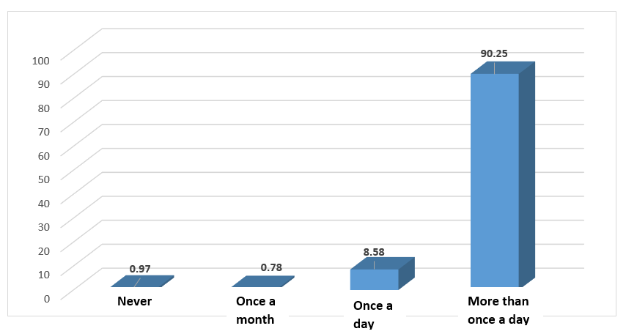
Data ANALYSIS
Experience with Internet usage

Slide 23
Data ANALYSIS
Use of E-learning Tools in Education
 | Teachers |  | Students |  | Total
 | Frequency | Percent | Frequency | Percent | Frequency | Percent
Never | 6 | 2.0 | 7 | 3.4 | 13 | 2.53
Occasionally | 160 | 52.3 | 50 | 24.2 | 210 | 40.94
Seldom | 62 | 20.3 | 26 | 12.6 | 88 | 17.15
More than once a day | 46 | 15.0 | 33 | 15.9 | 79 | 15.30
All the time | 32 | 10.5 | 91 | 44.0 | 123 | 23.98
Total | 306 | 100 | 207 | 100 | 513 | 100

Slide 24
Data Analysis
Model Assessment
Measurement Model Assessment
Structural Model Assessment

Slide 25
Data Analysis
Measurement Model Assessment
Reliability
Validity
Cronbach's α
Convergent
validity
Discriminant
validity
Composite Reliability
Average Variance Extracted
Fornel-Larcker Criterion
rho_A
Factor loadings
Cross-loadings
HTMT Criteria
New tool

Slide 26
Data ANALYSIS
Assessment the adequacy of the model
Variables | CA | CR | AVE | VIF | rho_A
Confidence | 0.908 | 0.927 | 0.646 | 3.531 | 0.91
Ease of Use | 0.749 | 0.839 | 0.567 | 2.066 | 0.77
Techno Pedagogy | 0.745 | 0.840 | 0.568 | 3.209 | 0.75
Human Resource Development | 0.913 | 0.935 | 0.742 | 2.031 | 0.92
Policy Adoption | 0.895 | 0.915 | 0.575 | 2.334 | 0.90
For Reliability, Cronbach Alpha (α), CR & rho_A should be > 0.70
For Convergent Validity, AVE (Average Variance Extracted) should be ≥ 0.50
For Multicollinearity, VIF (Variance Inflation Factor) should be ≤ 5.00

Slide 27
Inter correlation between the constructs and AVE (Fornell-Larker criterion)
 | ADOP | CON | EU | HRD | PA | TP
ADOP | 0.83
CON | 0.67 | 0.80
EU | 0.62 | 0.68 | 0.75
HRD | 0.59 | 0.71 | 0.67 | 0.86
PA | 0.42 | 0.41 | 0.30 | 0.38 | 0.76
TP | 0.51 | 0.51 | 0.40 | 0.41 | 0.69 | 0.75
All figures on the diagonals are greater than the figures beneath them.

Slide 28
Data ANALYSIS
Assessment the adequacy of the model
 | ADOP | CON | EU | HRD | PA | TP
ADOP
CON | 0.765
EU | 0.751 | 0.809
HRD | 0.666 | 0.888 | 0.806
PA | 0.466 | 0.451 | 0.344 | 0.412
TP | 0.636 | 0.623 | 0.515 | 0.501 | 0.832
All HTML ≤ 0.90

Slide 29
Data Analysis
Structural Model Assessment
Multicollinearity teste
Variance Inflation Factor (VIF)
,
Model Fit
R²
Q²
SRMR
Path Analysis
Significant Values

Slide 30

Data Analysis
Model Fit
R² predictive power of the constructs
R² ≥ 0.10
Coefficient of determination (R²)
Q² predictive relevance of the endogenous constructs
Q² ≥ 0
Predictive relevance (Q²)
SRMR absolute measure of model fit
SRMR ≤ 0.08
New tool
Standardized Root Mean Squared Residual (SRMR)

Slide 31

Data Analysis
Model Fit and Path Analysis
The coefficient of determination, R² (goodness of fit) should be equal to or over 0.10 (Falk & Miller, 2012).
The value of Q² (goodness of prediction) above zero shows that the model has predictive relevance (Urbach & Ahlemann, 2014).
Standardized Root Mean Squared Residual (SRMR) should be below 0.08 (Mplus, 2018; Parry, 2019).
(Source: Smart PLS, T- 7)
 | R² | Q² | SRMR
ADOP | 0.533 | 0.357 | 0.061
So the model is super fit

Slide 32
Data Analysis
Structural Model Assessment
Path Analysis
Significant Values
Path Coefficients
t-test
p-test
Confidence interval

Slide 33
Hypothesis testing /Path coefficient and its significances (T-8)
Hyp | Path | β | T Statistics | P Values | Confidence Interval |  | Decision
 |  |  |  |  | 2.50% | 97.50%
H₁ | CON -> ADOP | 0.354 | 5.544 | 0.000 | 0.229 | 0.479 | Supported
H₂ | EU -> ADOP | 0.270 | 5.636 | 0.000 | 0.174 | 0.364 | Supported
H₃ | HRD -> ADOP | 0.022 | 0.430 | 0.667 | -0.082 | 0.121 | Not supported
H₄ | PA -> ADOP | 0.059 | 1.354 | 0.176 | -0.026 | 0.147 | Not supported
H₅ | TP -> ADOP | 0.172 | 3.137 | 0.002 | 0.064 | 0.280 | Supported

Slide 34
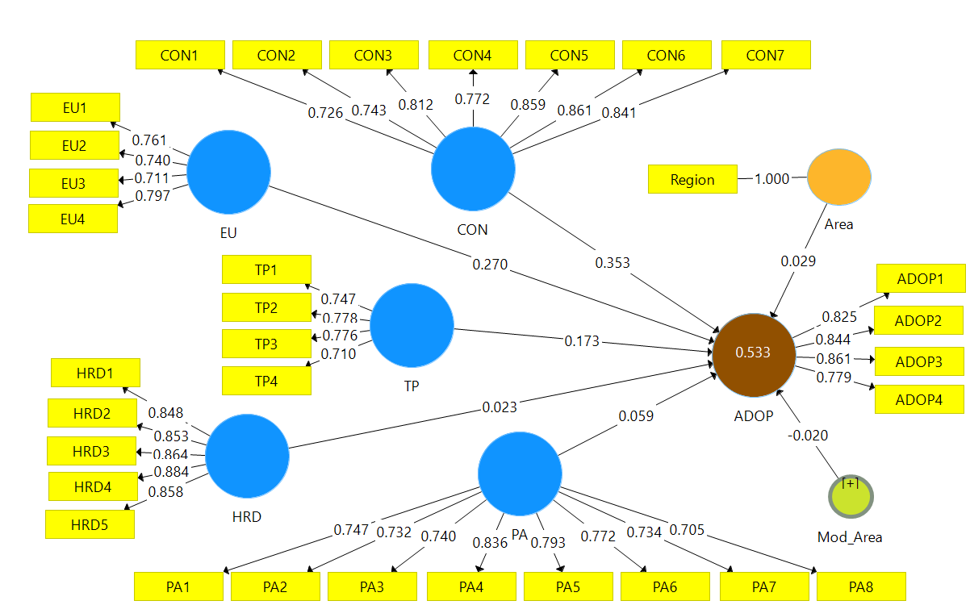
Graphical representations of the SmartPLS Structural Equation Model (SEM)-Path

Slide 35

Findings & Suggestions
H₃: Human resource development has an insignificant effect on M-learning adoption (Kathrin Reinke & TomasChamorro-Premuzic, 2014).
H4: The authority should have appropriate policy for technological infrastructures and availability, which is the opposite of the results (Khaddage et al., 2016).
… CONT

Slide 36
Findings & Suggestions
...insignificant for E-learning adoption in Bangladesh ?
Not depend on Wi-fi network
Cellular Phone Internet
Policy Adoption
Private 4G Network
Personal Smart Phone users
Teachers recruitments
Trained
HRD
Smart Phone user (S/T)
… CONT

Slide 37
Major Innovative
Extension of the TAM with three new constructs (new model)
Techno Pedagogy, Policy Adoption and HRD are new indicators with the TAM model
Explained 53.3% substantial variance, TAM 40%
‘Region’ as a moderating variable for E-learning technology acceptance
First E-learning study in Bangladesh for government higher education
HRD insignificant on E-learning adoption in Bangladesh
Policy Adoption on E-learning adoption in a cellular phone environment.

Slide 38
Recommendations
For Authority
This study developed a conceptual model (extension of TAM) with some new factors (Techno Pedagogy, Human Resource Development, User Confidence, and Policy Adoption) to execute the E-learning adoption in Bangladesh. The authority may consider the factors while designing the E-learning environment.
Human Resource Development has a vital factor in adopting new technologies and performing quality education (Table 7). More training programs should be initiated for teachers. Long-term and short-term policies should be implemented to achieve the 21st century and fulfil the target of sustainable development goals.
From the face to face interview, the study found a curriculum gap in digital literacy according to the demand of the current world. Hence, a technologically based curriculum should be revised to fulfil the essential and appropriate skills, knowledge, and capable intellectual and labour forces.

Slide 39
Recommendations
For Authority
From the face-to-face interview and focus group discussion, the study revealed that few technologies are expensive and beyond the institute's reach. Thus, the higher authority should support the stakeholders effectively to appreciate educational technology's spirit in this 21st-century education.
The study found that accepting new technology for its complex uses is problematic, so orientation should be arranged from time to time. Furthermore, seminars, symposiums, the conference should be arranged for the actual users.

Slide 40
Recommendations
For Teachers
More than 60% (Table 4) of respondents do not use technologies for education, though more than 76% use smartphones (Figure 2), and most of them (more than 99%) use the internet (Figure 3). So, it is badly needed to encourage technology for education.
A large number of respondents disclosed the unusable condition of available technologies in colleges. So, a more efficient plan should be taken to fix this problem (Table 2).
The study found that teachers feel anxious about using new technologies. The study suggested that teachers change their minds to accept new technologies to meet the new challenges of the 21st century.

Slide 41
Recommendations
For IT designer
This study developed a conceptual model (extension of TAM) with some new factors to execute the E-learning adoption in Bangladesh. The IT designer may consider these factors while designing the collaborative E-learning environment.
The study found that teachers feel anxious about using new technologies. So, IT designers need to develop the educational system user-friendly so that it is easy to use for the end users according to the demand of the current world. Furthermore, audio and video guides may be added to adequately use the technologies.

Slide 42
Recommendations
For researcher
The study was performed on government (public) colleges in Bangladesh. So further study may be executed on another educational institutes to generalize the model.
The study developed a conceptual model (extension of TAM) with some new factors (Techno Pedagogy, Human Resource Development, User Confidence, and Policy Adoption) to execute the E-learning adoption in Bangladesh. A new study may consider other factors to understand better E-learning performance.
Policy Adoption and Human Resource Development did not affect on Adoption of E-learning in the current research field. Further research should be considered for other environments.
The study found that teachers feel anxious about using new technologies. So, the study suggests that new researchers find the key factors due to form a collaborative educational system for teachers.

Slide 43


