Slide 1
Developing Human Capital Through Training: A Comparative Study on Two Selected Training Institutions in Bangladesh
JANNATUL FERDOUS, Ph.D.
Associate Professor Department of Public Administration Comilla University Cumilla-3506, Bangladesh

Slide 2



Introduction
The essence of SDGs has shifted the concern of the whole world from quantitative to qualitative change and it has emphasized generating productive and decent employment along with creating an accountable, transparent and effective institution of service delivery in the government sector.
Employee training is a learning experience that seeks a relatively permanent change in employees such that their ability to perform at their current job improves. This may mean changing what employees know, how they work, or their attitudes toward their jobs, co-workers, managers, and the organization.
Training and development are seen as one of the key practices of human resource management and it refers to the programs designed to teach the employees about the company essentials, educate them on the general rules of an organization, to provide them with technical knowledge which is considered important to complete the job tasks effectively and to eradicate the probable imperfections at work.

Slide 3
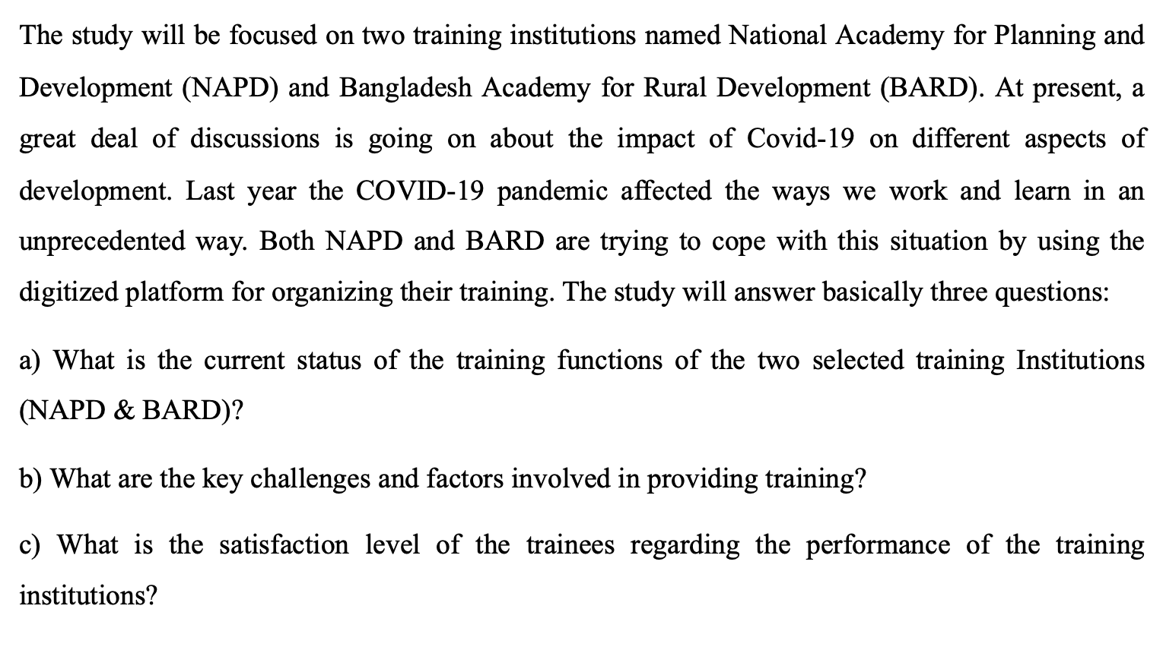

Slide 4

Bangladesh has witnessed its best times in terms of economic growth in the last decade or so, speeding on its way to lower middle income status. Now is the most opportune moment for further innovative growth by efficiently focusing on the skills gaps in various sectors.
This statement has been backed by numerous skill development projects and fund allocation; strict implementation plans have also been laid out, targeting mid-level managers in many sectors where the nation lacks the right kind of employees.
A nationwide skill reformation movement is essential, guided by the right type of training in chosen sectors. From an industry-academy perspective, it is important that industry-specific skills are strategically integrated into courses and curricula designed to address jobs for the 21st century.
Training plays a vital role to bring change in employees attitude, in building values and to implement development project. Secondly those who have been working in job for long time and have lacking in working skill, training is an essential for them to enhance the quality of their work.
Training, if properly crafted, not only provides trainees with right competencies for doing the job but also brings about positive and permanent change in their actions and behaviour.

Slide 5
Research Objectives
General objectives
The general objectives of the study explore the development of human capital through training at two selected training institutions in Bangladesh.
Specific objectives
The purpose of this study is to examine how the two training institutions (NAPD & BARD) under study develop human capital.
To provide some recommendations to overcome challenges (if any) and ways to enhance the quality of training.

Slide 6
Scope of the Study
National Academy for Planning and Development (NAPD) is mandated for organizing training and conducting research in the area of development planning and project management for achieving Sustainable Development Goals (SDGs) by 2030 and to materialize the national vision of transforming Bangladesh into a developed nation by 2041. The vision of NAPD was established as one of the country's leading training institutes on planning and development by 2025.
Bangladesh Academy for Rural Development (BARD) was established in 1959 basically as a training institute (BARD, 2013). The Academy has made substantial contributions towards rural development in the country by evolving several innovative rural development programmes and institutions, which have been replicated throughout the country. It still continues to mold new ones. It has also provided planners and policymakers with information and insight into the problems of rural development in the country through its integrated approach to training, research, and action research.

Slide 7
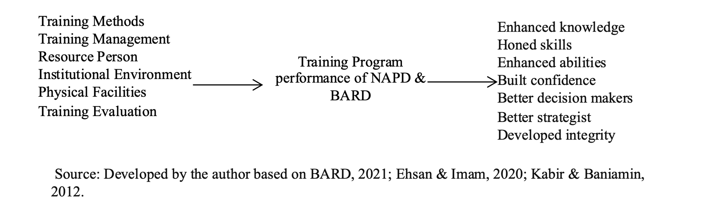

Slide 8

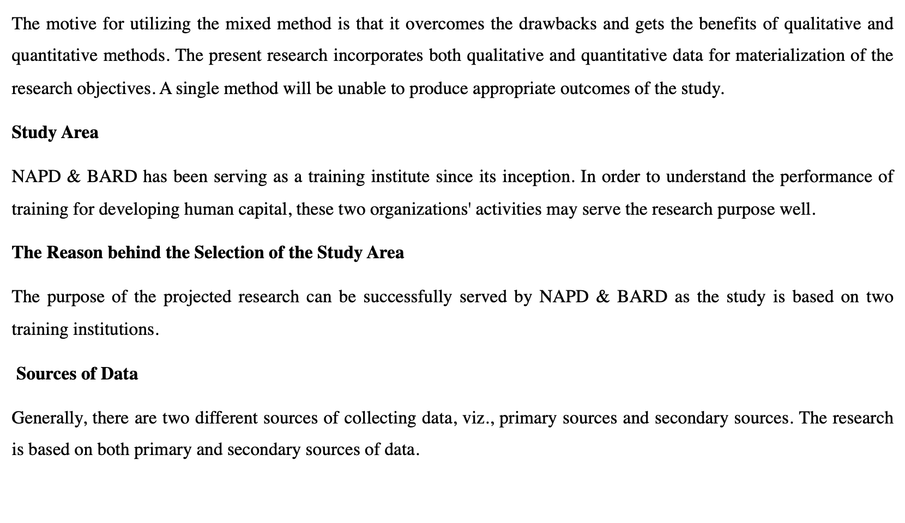

Slide 9
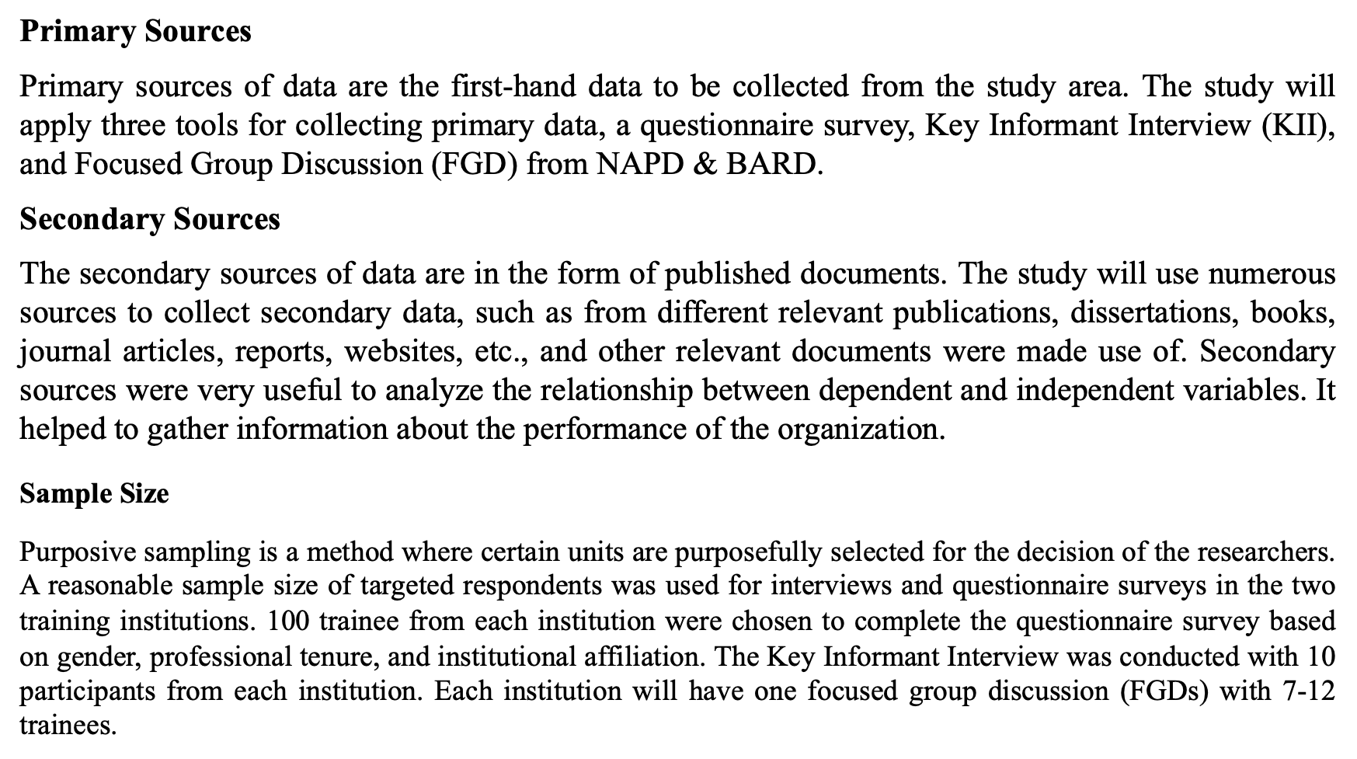

Slide 10
In this research data will be collected through a questionnaire survey, key informant interview (KII), and Focused Group Discussion (FGD) methods. The mixture of all three methods assisted to assemble consistent and effective data.
Data Analysis
The information gathered through the survey questionnaire, key informant interview (KII), and focused group discussion (FGD) was used to present an overview of human capital formation. To analyze the data, the researcher used simple computing. In addition, they are utilizing the triangulation method to ensure that the information is dependable, valid, and correct.

Slide 11
Findings
Criteria | Name | Excellent | Very Good | Good | Average | Little | Not satisfactory
Appropriateness of Training Methods | NAPD | (38%) | (38%) | (17%) | (7%) | (0%) | (0%)
 | BARD | (27%) | (38%) | (28%) | (8%) | (0%) | (0%)
The level of Training Management System | NAPD | (33%) | (43%) | (10%) | (13%) | (0%) | (0%)
 | BARD | (27%) | (45%) | (25%) | (3%) | (0%) | (0%)
Assessing the Qualifications of Resource Person | NAPD | (33%) | (37%) | (23%) | (7%) | (0%) | (0%)
 | BARD | (19%) | (34%) | (23%) | (22%) | (0%) | (0%)
Evaluating the Adequacy of Institutional Environment | NAPD | (23%) | (30%) | (34%) | (0%) | (7%) | (6%)
 | BARD | (58%) | (33%) | (8%) | (2%) | (0%) | (0%)
Assessing Physical Facilities Support | NAPD | (30%) | (37%) | (20%) | (13%) | (0%) | (0%)
 | BARD | (41%) | (39%) | (16%) | (2%) | (3%) | (0%)
Quality Assessment of Training Evaluations | NAPD | (37%) | (37%) | (17%) | (10%) | (0%) | (0%)
 | BARD | (33%) | (39%) | (22%) | (6%) | (0%) | (0%)
The Role of Training Institutes in Ensuring Quality Human Capital Development | NAPD | (37%) | (43%) | (17%) | (3%) | (0%) | (0%)
 | BARD | (28%) | (44%) | (25%) | (3%) | (0%) | (0%)

Slide 12
Recommendations
Training Methods
Incorporate a variety of interactive training methods: Encourage the use of diverse training methods such as simulations, role-plays, and experiential learning activities. This will cater to different learning styles, promote active engagement, and enhance knowledge retention among participants.
Integrate technology-enabled learning: Explore the use of technology-enabled learning platforms, such as virtual reality and online simulations, to create immersive and interactive training experiences. This can expand access to training and provide opportunities for remote or self-paced learning.
Training Management:
Conduct comprehensive training needs assessments: Prioritize conducting thorough training needs assessments to identify specific skill gaps and tailor the training programs accordingly. This will ensure that the training content and delivery methods align with the evolving needs of participants and industries.
Enhance training program design: Develop training programs with clear learning objectives, well-sequenced topics, and appropriate time allocation for each session. Incorporate feedback mechanisms to continuously evaluate and update the program content to meet the changing demands of the labor market.

Slide 13
Recommendations (Cont.)
Resource Person:
Continuously develop and update resource persons' skills: Implement regular training and professional development opportunities for resource persons to enhance their instructional and facilitation skills. This will ensure that they remain up-to-date with the latest industry practices and teaching methodologies.
Foster collaboration among resource persons: Encourage resource persons to collaborate and share best practices with colleagues across disciplines and institutions. This will promote a culture of continuous learning and enable the exchange of knowledge and expertise.
Institutional Environment:
Strengthen support systems for participants: Establish mentorship programs, peer learning groups, or alumni networks to provide ongoing support and guidance to participants beyond the training period. This will facilitate knowledge sharing, networking, and continued professional growth.
Promote a culture of innovation: Encourage institutions to foster an environment that supports innovation in training approaches and methodologies. Create platforms for resource persons and participants to experiment with new ideas and technologies, fostering a culture of continuous improvement.

Slide 14
Recommendations (Cont.)
Physical Facilities:
Regularly assess and upgrade training facilities: Conduct regular assessments of physical facilities and equipment to ensure they are up to date and meet the changing needs of training programs. Address any infrastructure gaps and provide access to modern training tools and technologies.
Create adaptable learning spaces: Design flexible learning spaces that can accommodate different training formats and support collaborative and interactive learning. Incorporate technology-enabled facilities, such as multimedia systems and high-speed internet connectivity, to enhance the learning experience.
Training Evaluation:
Implement long-term evaluation measures: Develop evaluation frameworks that capture the long-term impact of training on participants' professional growth and performance. Consider conducting follow-up evaluations at regular intervals to assess the sustained application of skills acquired through training.
Use data-driven insights for program improvement: Collect and analyze feedback from participants, employers, and other stakeholders to identify areas for program improvement. Utilize this data to refine training content, delivery methods, and evaluation processes to enhance the effectiveness and relevance of the programs.

Slide 15


Thank you

