Slide 1
Theory of Structure(26454)
5th Semester
Civil Technology
Providan-2022
Presented By
Sabina Shahanaz Instructor STEP(Civil) Mymensingh Polytechnic Institute Maskanda, Mymensingh

Slide 2
Shear Force And Bending Moment Of Beams

Slide 3
What is shear force Diagram?
The use of shear force diagram is to calculate the shear force at different sections. In some complicated cases it is difficult to calculate shear force so it is easier to make SFD and calculate shear force.
The shear force at a section of a beam is the force that shears off the section and is obtained as the algebraic sum of all forces including the re
The normal convention used in most engineering applications is to label a positive shear force one that spins an element clockwise (up on the left, and down on the right). Likewise the normal convention for a positive bending moment is to warp the actions acting normal telement in a "u" shape manner (Clockwise on the left, and counterclockwise on the right). Another way to remember this is if the moment is bending the beam into a "smile" then the moment is positive, with compression at the top of the beam and tension on the bottom.o the axis of the beam either to the left or right of the beam.

Slide 4
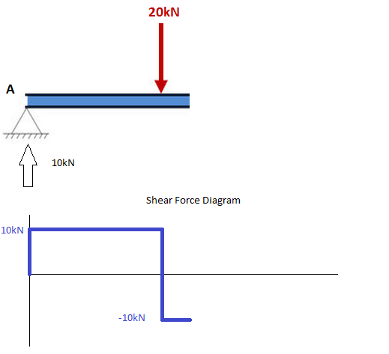
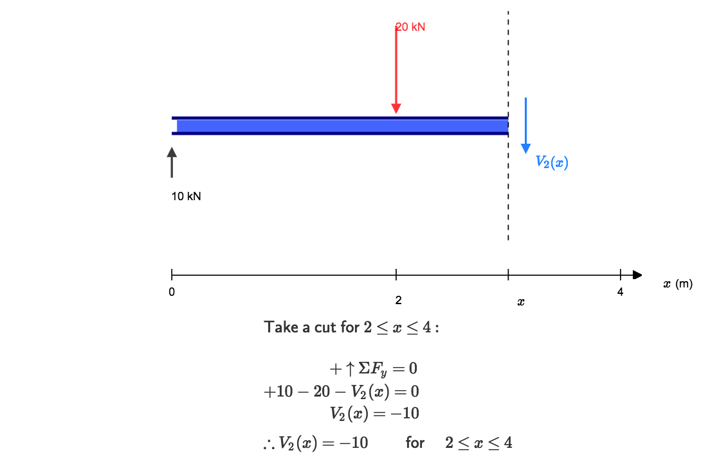
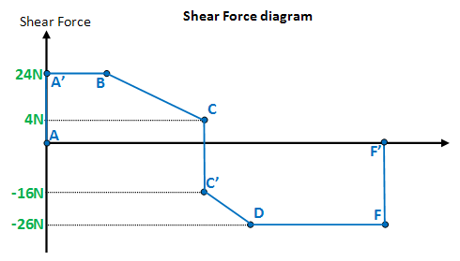

Slide 5
What is Bending Moment Diagram?
A bending moment is the reaction induced in a structural element when an external force or moment is applied to the element causing the element to bend. The most common or simplest structural element subjected to bending moments is the beam. The diagram shows a beam which is simple.Shear and bending moment diagrams are analytical tools used in conjunction with structural analysis to help perform structural design by determining the value of shear force and bending moment at a given point of a structural element such as a beam.ply supported at both ends.

Slide 6
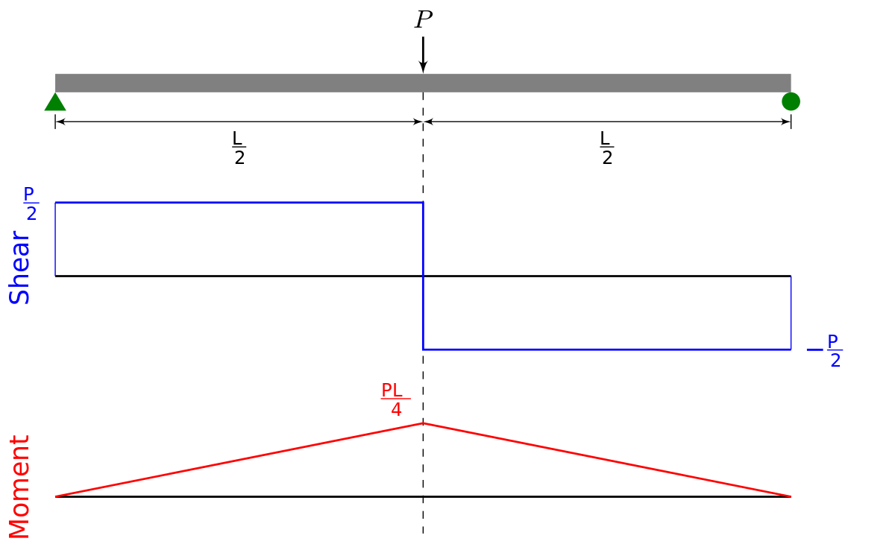
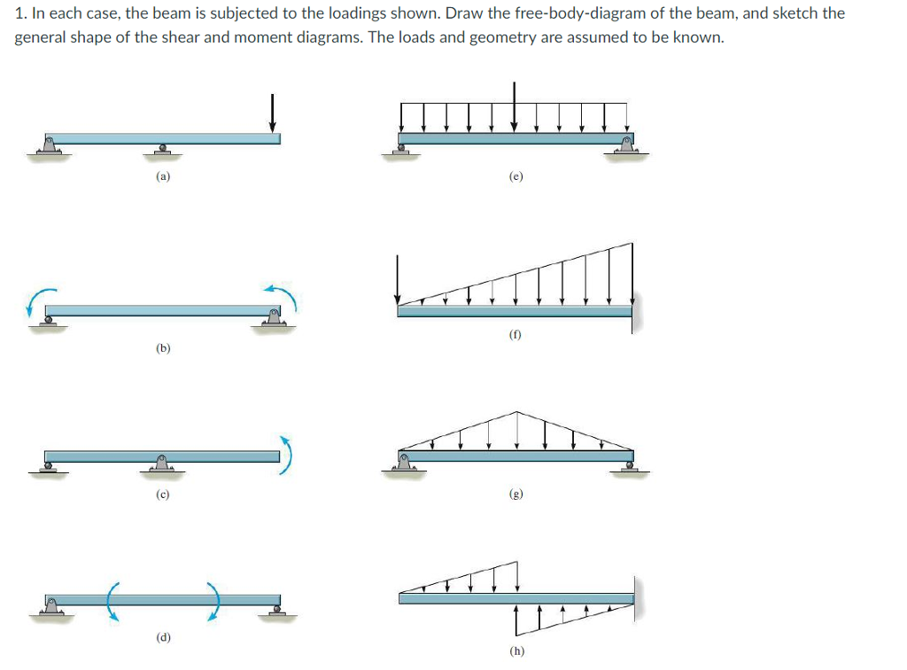
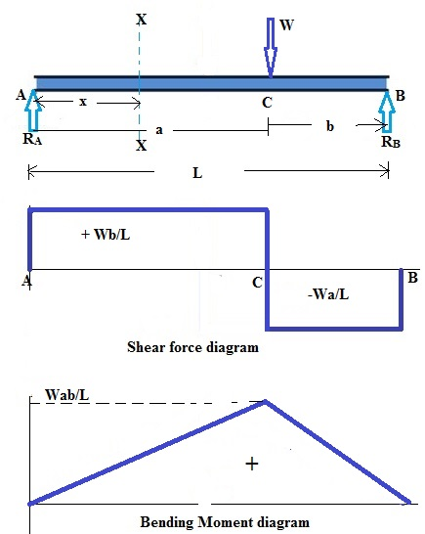
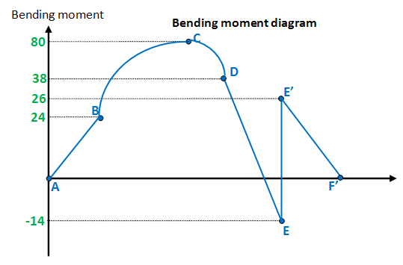

Slide 7
Theory Of Structure(66454) Instructor:Eng.Md.Ashraful islam Chapter -2
Bending Stresses In Beams:

Slide 8
About bending stresses in beams!
Bending stress is the normal stress that is induced at a point in a body subjected to loads that cause it to bend. When a load is applied perpendicular to the length of a beam (with two supports on each end), bending moments are induced in the beam. ... The bottom fibers Bending stress is the normal stress that is induced at a point in a body subjected to loads that cause it to bend. When a load is applied perpendicular to the length of a beam (with two supports on each end), bending moments are induced in the beam.f the beam undergo a normal tensile stress.

Slide 9
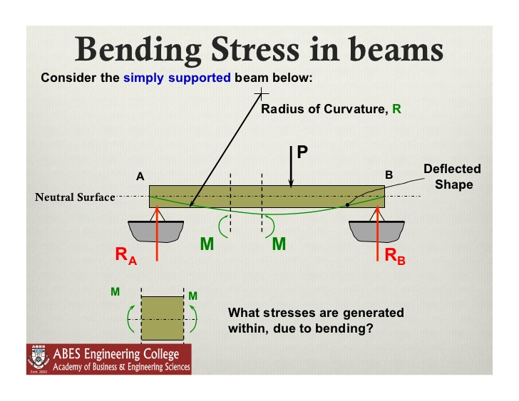
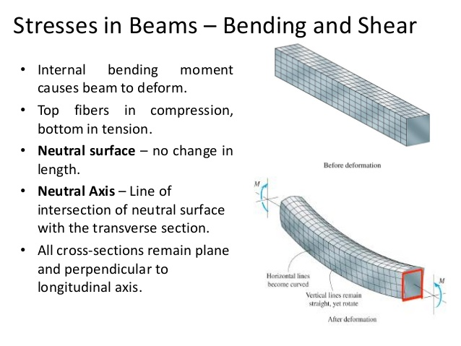
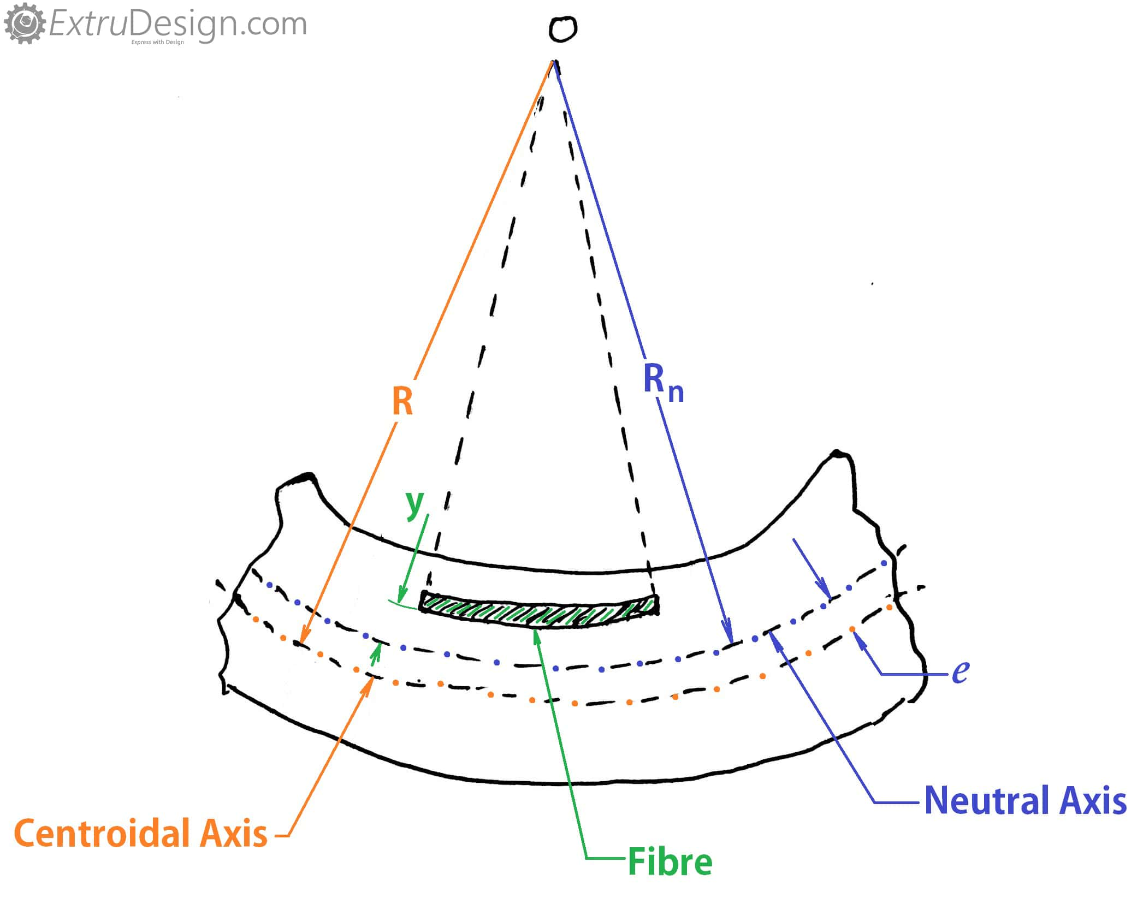

Slide 10

Theory Of Structure…….
66454

Slide 11
Chapter-3 About shearing stresses in beams!
The shearing stress in beam is defined as the stress that occurs due to the internal shearing of the beam that results from shear force subjected to the beam. It is denoted by the symbol t and is expressed in thThe formula for shear stress is tau = F / A, where 'F' is the applied force on the member, and The WSS is calculated form the formula: (a) WSS = WSR x P, where WSR is the wall shear rate and P is the viscosity (0.01 for PBS). The WSR is calculated form the formula: (b) WSR = 8 x Vm / D, where Vm is the fluid mean velocity and D is the diameter of the tube (1.025 mm in case of Drummond glass capillary tubes).'A' is the cross-sectional area of the member.e unit of psi or N/mm
When a beam is subjected to a transverse loading, a normal and a shearing stresses result in the beam. The influence of the shearing stress in the beam does not disturb the influence of the bending stress. The shear stress applied on the vertical surface of the beam exerts the same identical stress on the horizontal surfaces of the beam. Generally, the beam subjected to the transverse load exerts the longitudinal shear stress in the beam.
².

Slide 12
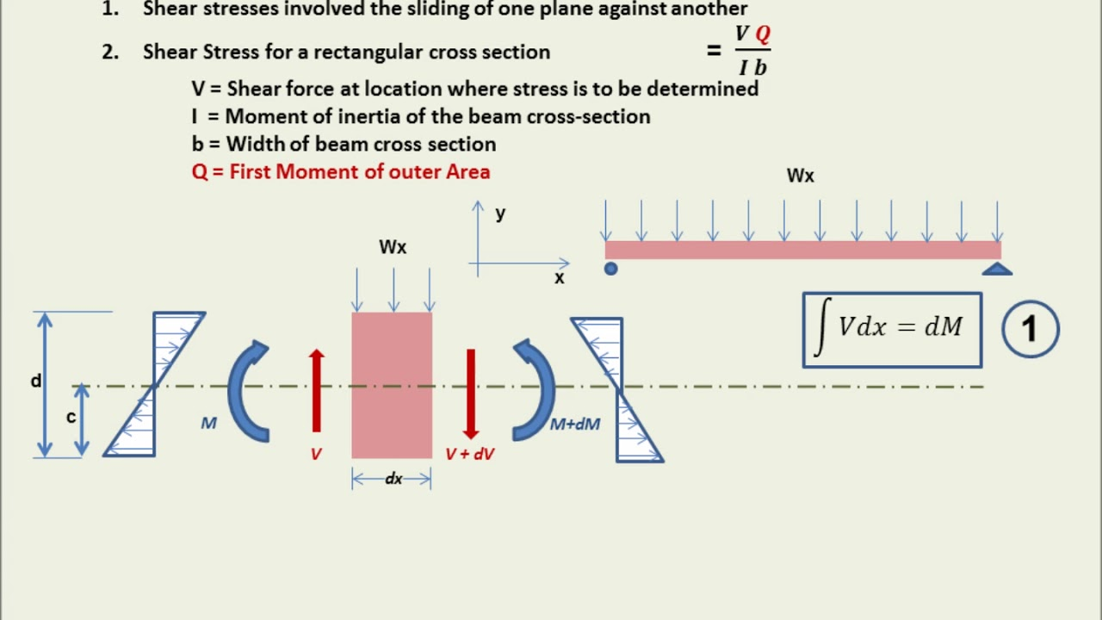

Slide 13
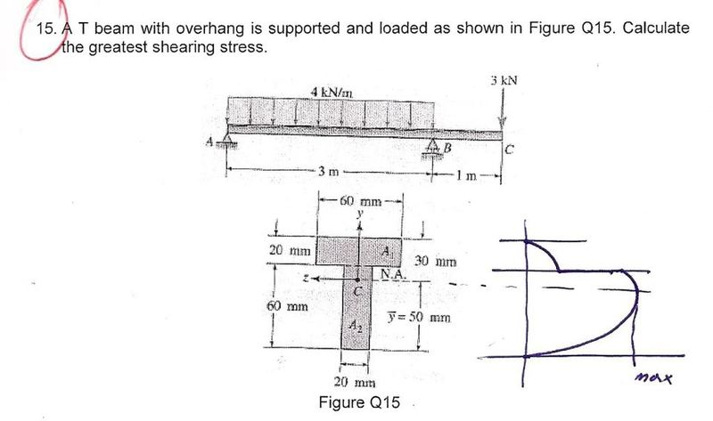

Slide 14
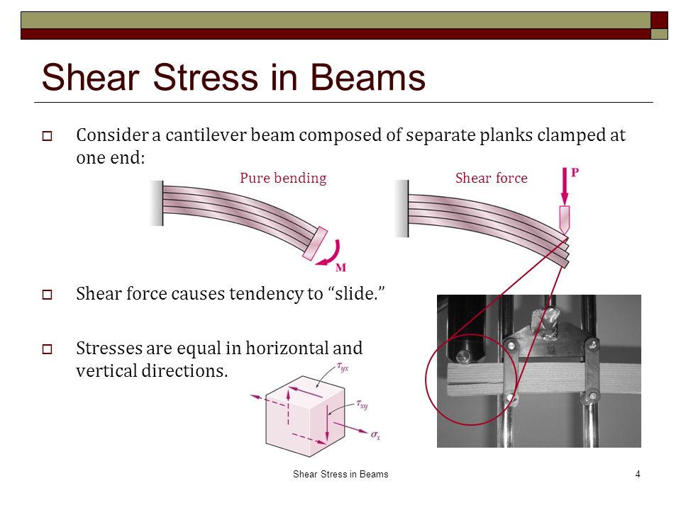

Slide 15

Theory of Structure Eng.Ashraful Islam
66454

Slide 16
About Deflection Of Beams…………….
In engineering, deflection is the degree to which a structural element is displaced under a load. ... The deflection of beam elements is usually calculated on the basis of the Euler–Bernoulli beam equation while that of a plaFor cantilevered beams, the maximum deflection will occur when the load is located at the free end of the beam, while for simply supported beams, maximum deflection will occur when the load is located in the center of the beamte or shell element is calculated using plate or llowable deflection is generally expressed as a fraction of the span, in inches. All structural members will deflect or flex under load. ... For example, the allowable deflection of a 12ft span floor joist with plaster (L/360) is 0.4" (12ft divided by 360).Jun 5, 2019ell theory….

Slide 17
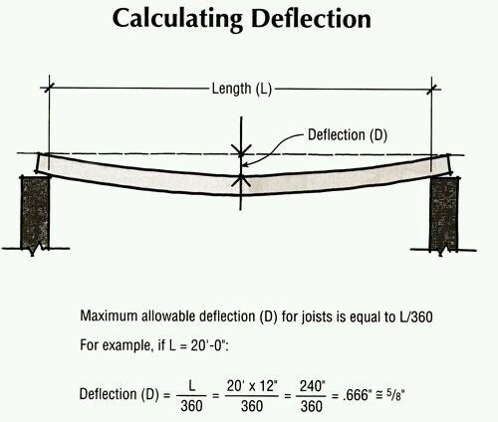
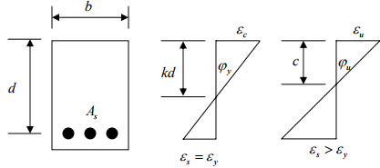
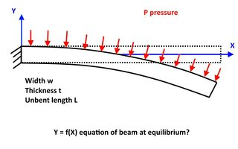

Slide 18
Theory Of Structure-66454 instructor:Eng.Ashraful islam
Concept Of Steel Structure And Joints…….

Slide 19
What is steel Structure?
Structural steel is a category of steel used for making construction materials in a variety of shapes. Many structural steel shapes take the form of an elongated beam having a profile of a specific cross section. Structural steel shapes, sizes, chemical composition, mechanical properties such as strengths, storage practices, etc., are regulated by standards in most industrialized countries.

Slide 20
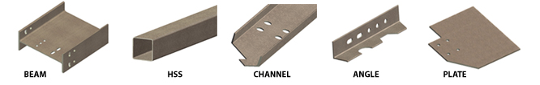
A steel building is a metal structure fabricated with steel for the internal support and for exterior cladding, as opposed to steel framed buildings which generally use other materials for floors, walls, and external envelop

Slide 21
What types of Math does a structural engineer use?
We rely heavily on the mechanics and calculus which Newton developed in the 17th century, together with linear algebra. Most problems boil down to solving the Euler–Bernoulli beam equation (usually the time-independent one, where inertial forces are disregarded).

Slide 22


Slide 23

Theory Of Structure-66454 Instructor:Eng.Ashraful Islam………..
About welded Connections….

Slide 24
About Welded Connection!
5.7.2 Welding. Welded connections are connections whose components are joined together primarily by welds. ... Although fillet welds are generally weaker than groove welds, they are used more often because they allow for larger tolerances during erection than groove welds.

Slide 25
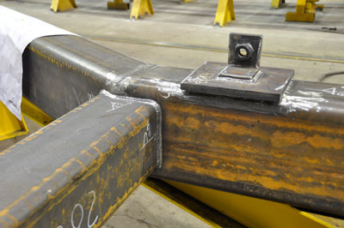
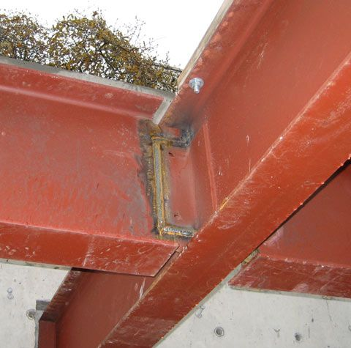
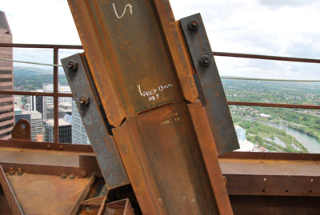

Slide 26
AdvAdvantages of Welding antages of Welding
Welded joints are more economical as less labor and less material is required. The efficiency of welded joint is more than that of the riveted joint. ... The speed of fabrication is faster in comparison with the riveted joints. Complete rigid joints can be provided with welding process.

Slide 27
Theory Of Structure-66454
Instructor:eng.Ashraful Islam

Slide 28
Action offerees in frames……..

Slide 29
What is frame in civil engineering?
Frame structures are the structures having the combination of beam, column and slab to resist the lateral and gravity loads. These structures are usually used to overcome the large moments developing due to the applied loading.

Slide 30
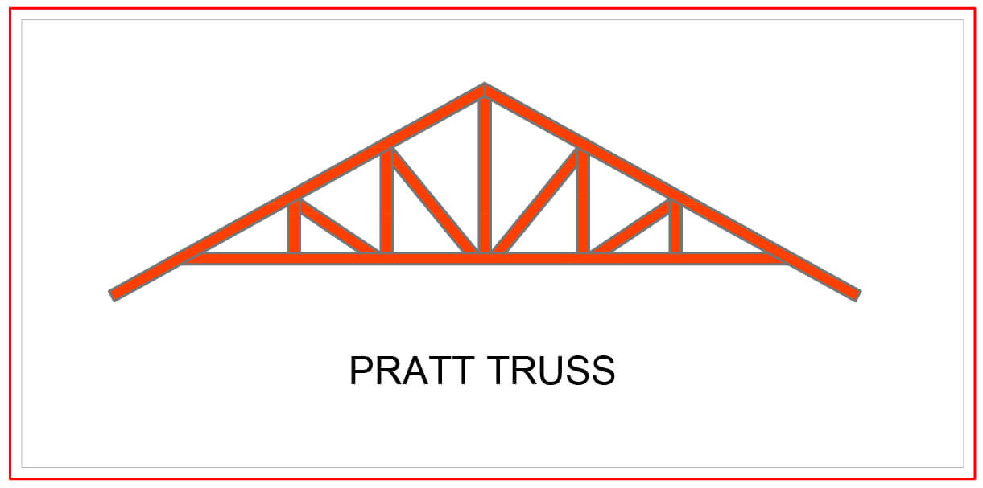

Slide 31
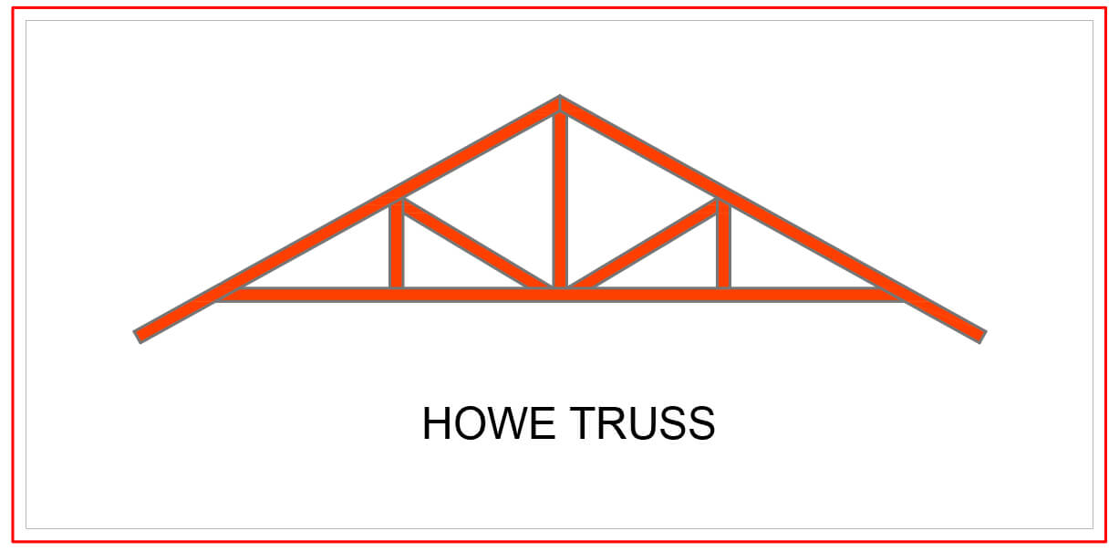

Slide 32
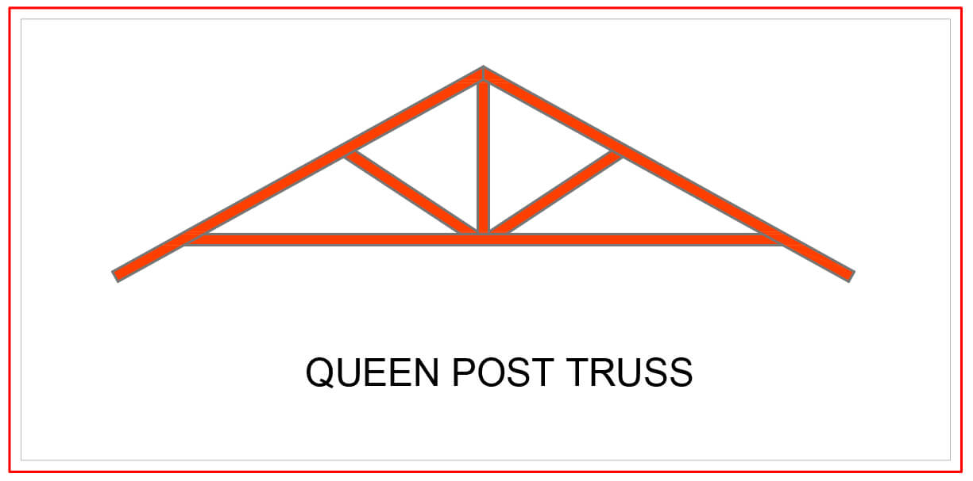

Slide 33
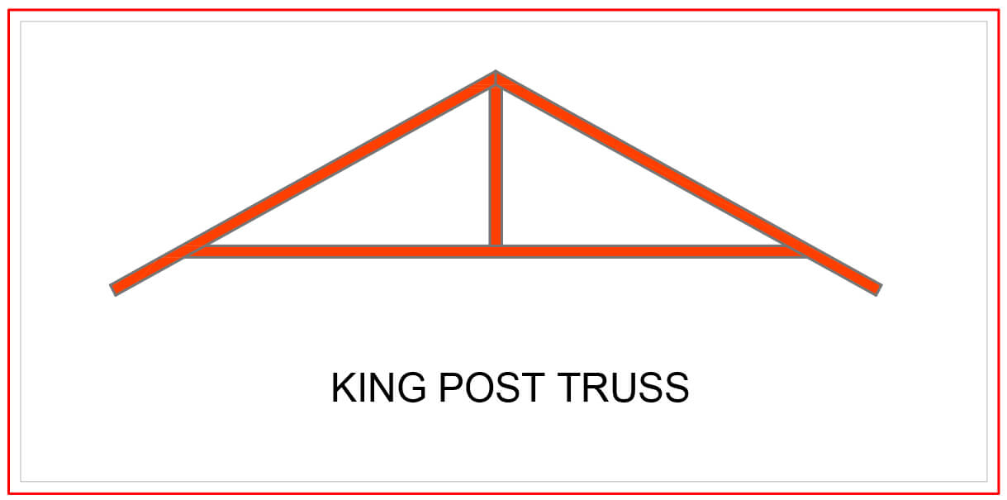

Slide 34
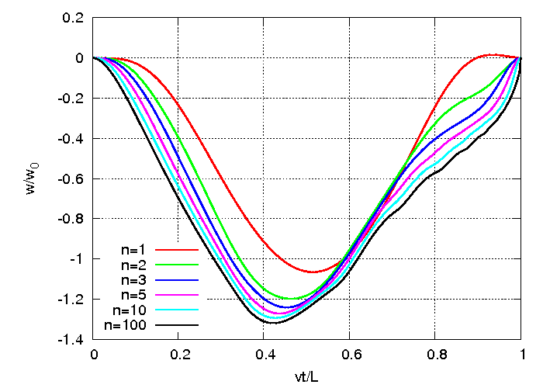
Theory Of Structure-66454 Instructor:Eng.Ashraful Islam

Slide 35
Moving load!!!
In structural dynamics this is the load that changes in time the place to which is applied. Examples: vehicles that pass bridges, trains on the track, guideways, etc. In computational models the load is usually applied as:
a simple massless force,
an oscillator,
an inertial force (mass and a massless force).

Slide 36
Numerous historical reviews concerning the moving load problem exist (for example,^{[1][2]}). Several publications deal with similar problems.^{[3]}
The fundamental monograph is devoted to massless loads.^{[4]} Inertial load in numerical models are described in ^{[5]} Unexpected property of differential equations that govern the motion of the mass particle travelling on the string, Timoshenko beam, and Mindlin plate is described in.^{[6]} It is the discontinuity of the mass trajectory near the end of the span (well visible in string at the speed v=0.5c). The moving load significantly increases displacements. The critical velocity, at which the growth of displacements is the maximum, must be taken into account in engineering projects. Structures that carry moving loads can have finite dimensions or can be infinite and supported periodically or placed on the elastic foundation.
Consider simply supported string of the length l, cross-sectional area A, mass density ρ, tensile force N, subjected to a constant force P moving with constant velocity v. The motion equation of the string under the moving force has a form

Slide 37
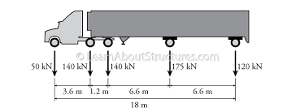

Slide 38
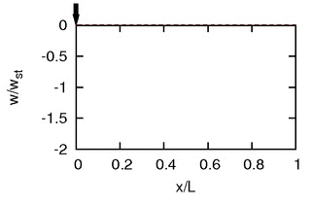
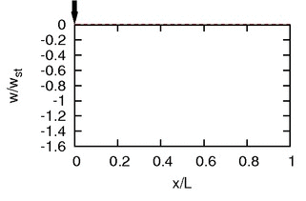
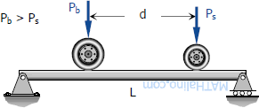

Slide 39
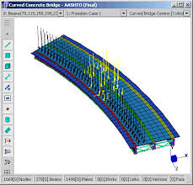
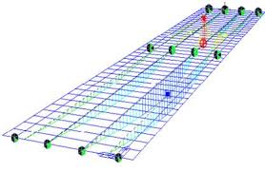

Slide 40
Theory of structure 66454
Instructor:Eng.Ashraful Islam

Slide 41
Define cylindrical shells!
What is cylindrical shell?
The cylindrical shell method. ... The volume of a cylinder of radius r and height h is . The volume of the shell between two cylinders, of the same height, one of radius r₁ and the other of radius r₂ > r₁ is , where is the average radius and is the change in radius.
Understanding the Formula
The shell method relies on an easy geometrical formula. A very thin cylindrical shell can be approximated by a very thin rectangular solid. ... Thus, the volume of the shell is approximated by the volume of the prism, which is L x W x H = (2 π r) x h x dr = 2πrh dr.

Slide 42
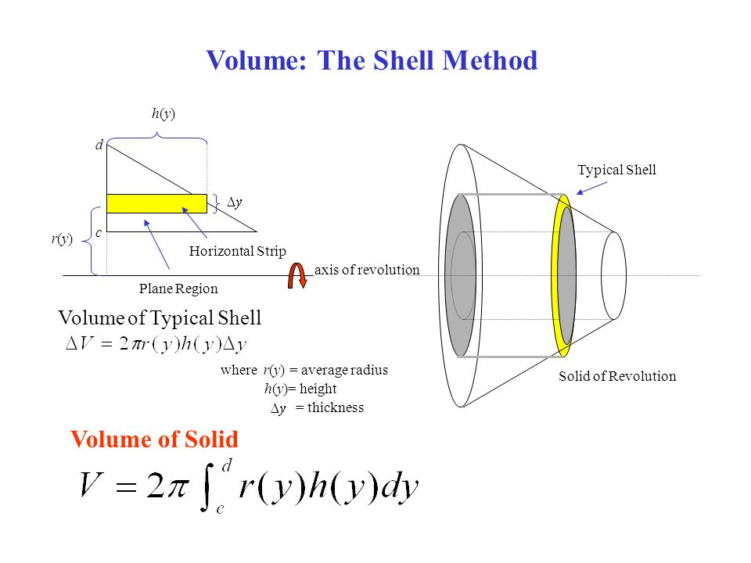
What is the difference between washer and shell method?
The disk method is typically easier when evaluating revolutions around the x-axis, whereas the shell method is easier for revolutions around the y-axis---especially for which the final solid will have a hole in it (hence shell).

Slide 43
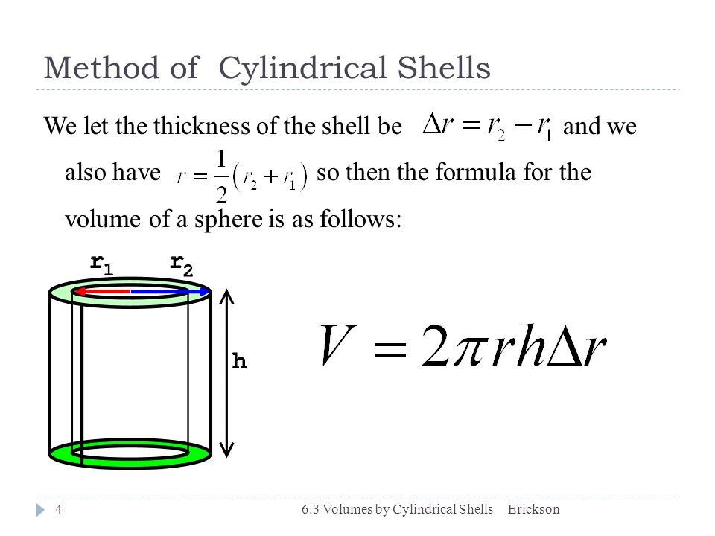

Slide 44
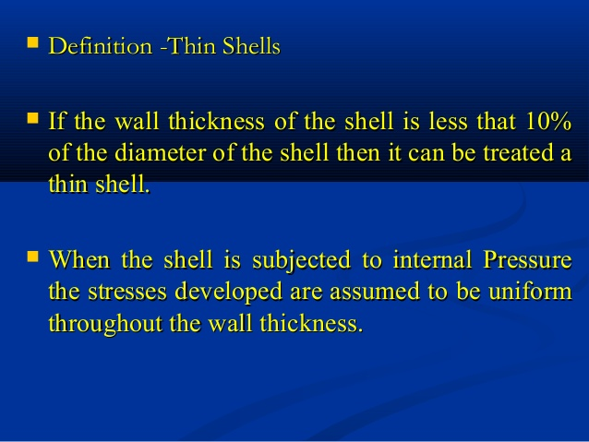

Slide 45
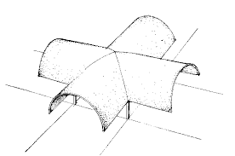
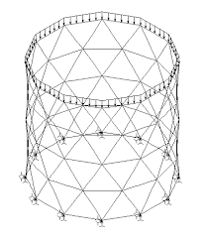
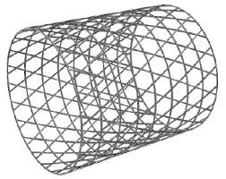

Slide 46
Thank you for watching……

