Slide 1


ENGINEERING
Subject Code:26455
5th Semester Civil Technology , 2022 Probidhan
Presented by:
MD. ROMAN MIA
Part Time Teacher ( Civil )
Mymensingh Polytechnic Institute

Slide 2
Chapter No-01
Understand the different sources of Water
1.Identify different sources of water
2. Explain the Hydrological cycle.
3.State the advantages and disadvantages of ground water.
4.Mention the advantages and disadvantages of surface water.
5. Distinguish between the ground water supply and surface water supply in respect to quality of water.
6. Explain rain water harvesting.

Slide 3
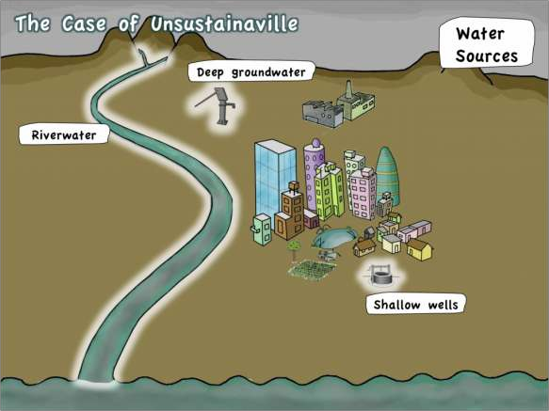
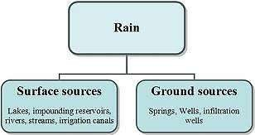
MAIN SOURCES OF
WATER

Slide 4
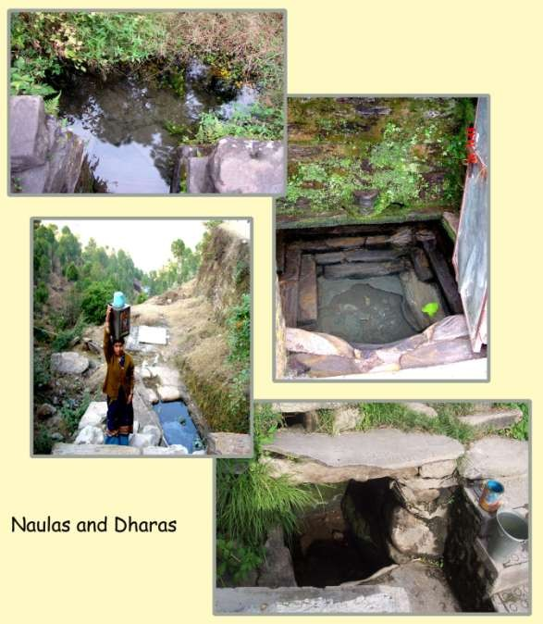
NATURAL RESOURCES OF
WATER

Slide 5
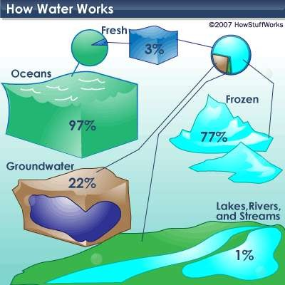
PERCENTAGE OF WATER USED DAILY

Slide 6
Chapter No-02
Understand the various aspects of consumption of water
1.Explain the influence of the factor which affects per capita consumption of water:
a. Size of City
B . Characteristics of population
c. Industries and commercial organization
d. Climate Condition
e. Metering of water

Slide 7
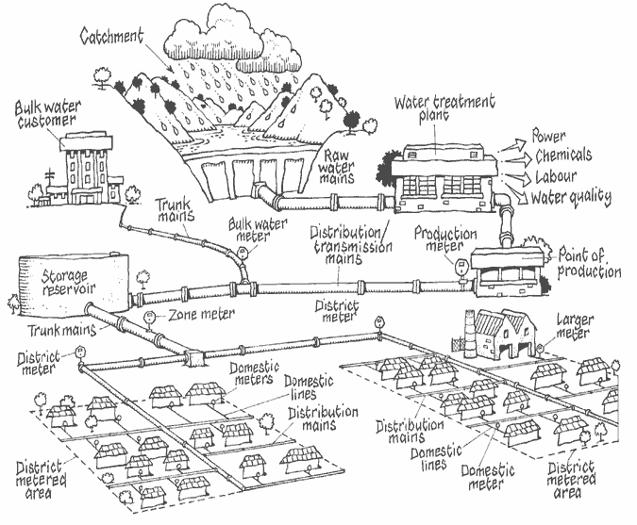
WATER DISTRIBUTION SYSTEM

Slide 8
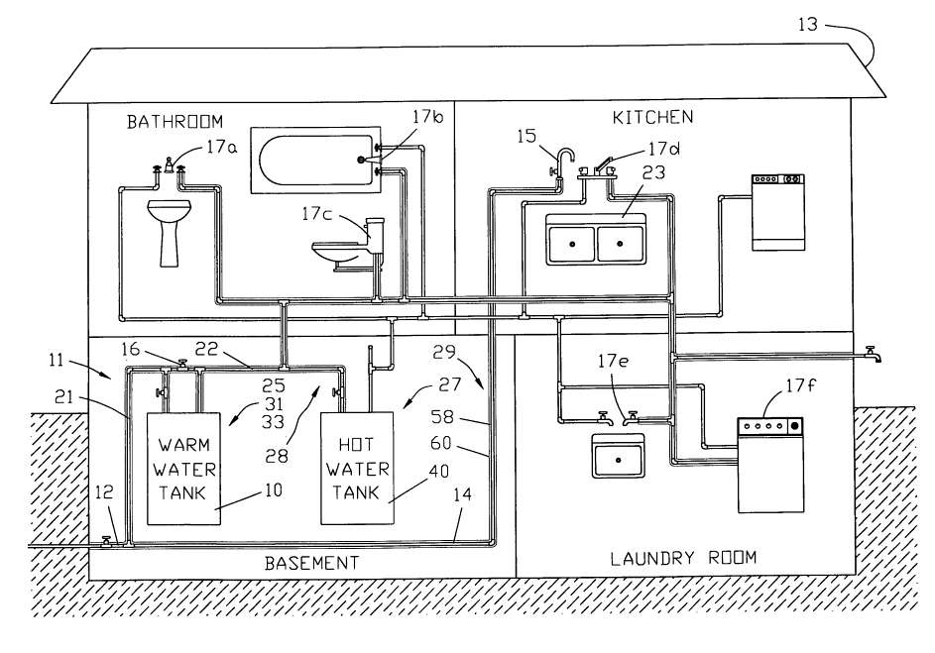
Water distribution system

Slide 9
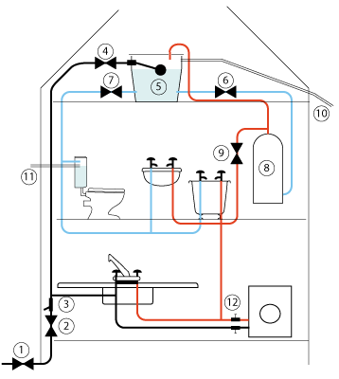
WATER DISTRIBUTION SYSTEM

Slide 10

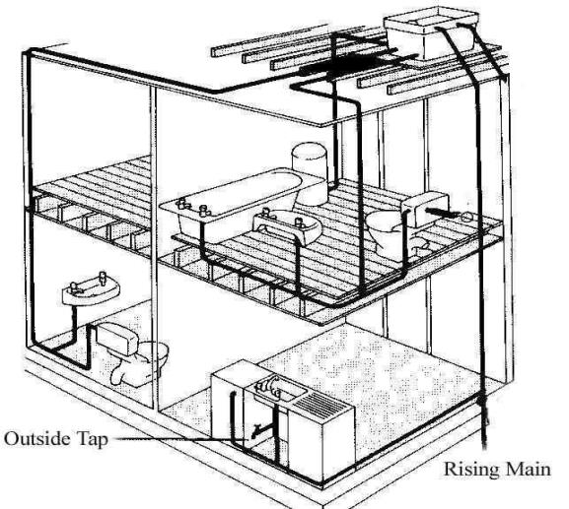
INDIRECT WATER SUPPLY
Water going to overhead tank and then the water is supplied to different floors by gravity

Slide 11
Chapter no-03
Understand the different type of pipes & pipe joints used in water supply and the reasons for corrosion in metal pipes.
Classify the different type of pipes according to size ,materials ,quality and allowable stresses used in Bangladesh.
2. Explain the causes of corrosion of metal pipes.
3. Describe the methods of prevention and protection against corrosion.
4. Explain the causes of deterioration in non metal pipes.
5. Describe with sketches the different joints used in pipes.
6. Describe with sketches the fittings of pipes and valves used.

Slide 12
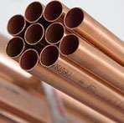
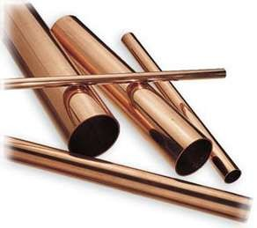
HOLLOW PIPES

Slide 13
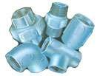
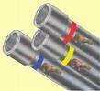

GALVANISED IRON (G. I . PIPES)

Slide 14
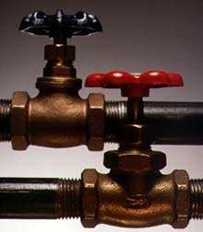
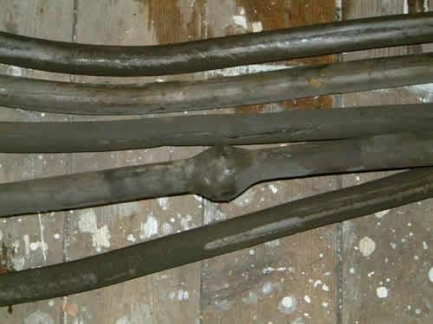
LEAD P I PES

Slide 15
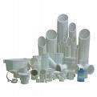

PVC PIPES

Slide 16
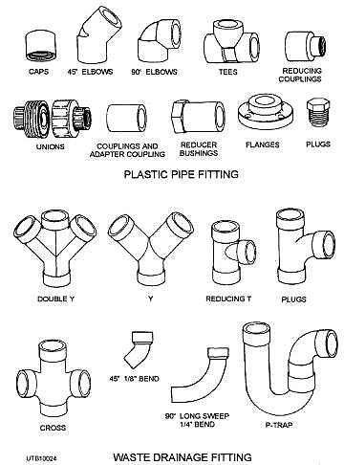
JOINTS

Slide 17
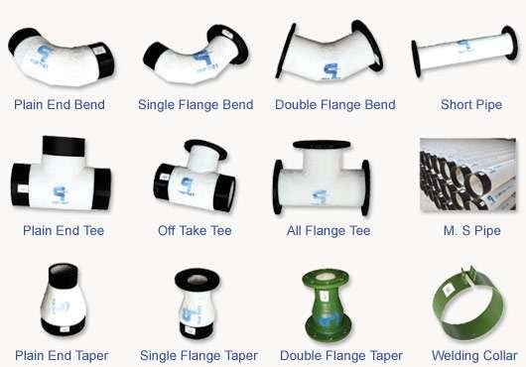
JOINTS

Slide 18
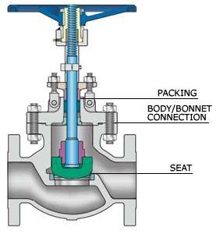

GATE VALVE

Slide 19
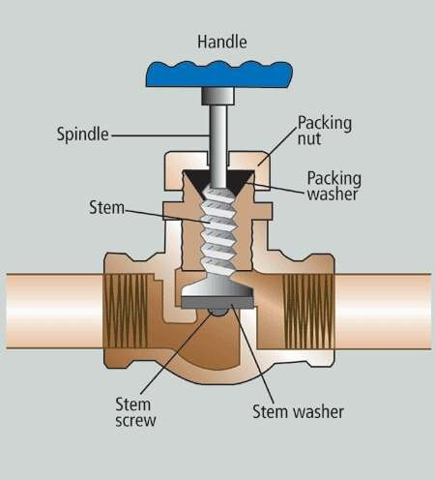
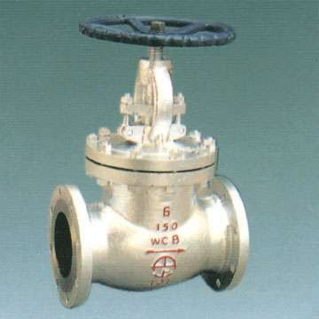
GLOBE VALVE

Slide 20
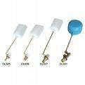

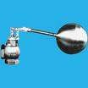
RELIEF AND FLOAT VALVE

Slide 21
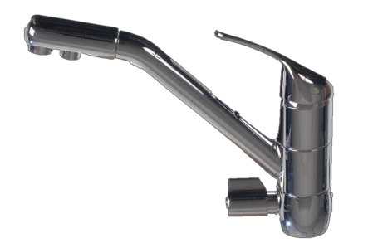
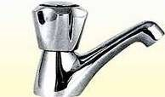
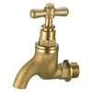
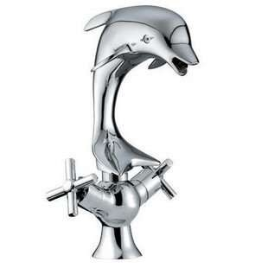
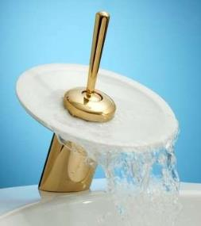
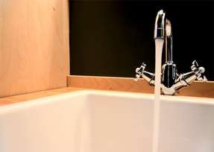
TAP OR BIB COCK

Slide 22
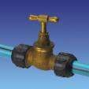
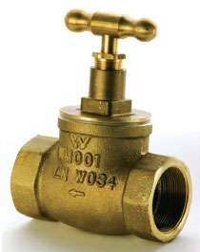
STOP COCK

Slide 23
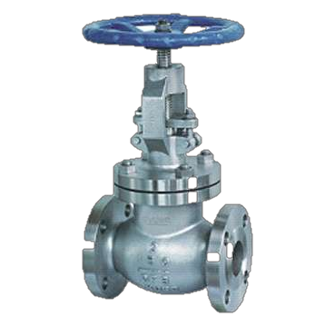
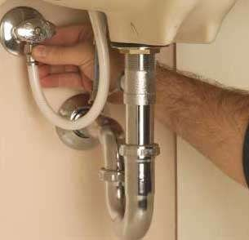
VARIOUS FITTINGS –GLOBE VALVE

Slide 24
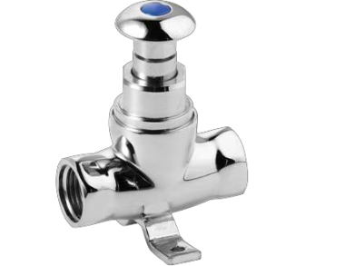
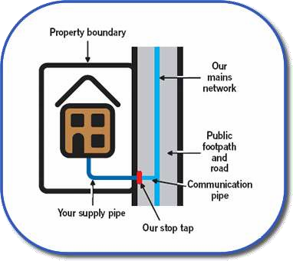
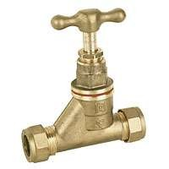
STOP TAP

Slide 25
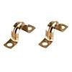
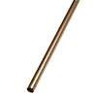
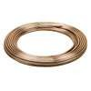
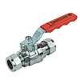
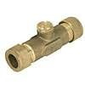
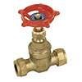
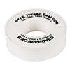
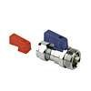
VARIOUS VALVES , TUBES AND PIPES
Copper Pipe
Clips 22mm
Copper Tube
15mm × 20m
Micro bore Copper Tube 10mm × 25m
Pegler Ball Valve
Red 15mm
Pegler Double Check Valve 15mm
Pegler Gate Valve 22mm
Pegler Washing Machine Tap 15mm x ¾""
PTFE Tape 12m Pk of 10

Slide 26
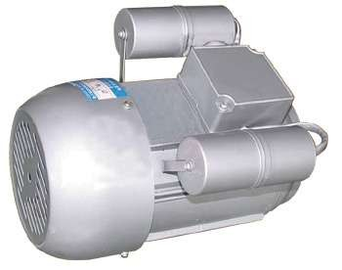
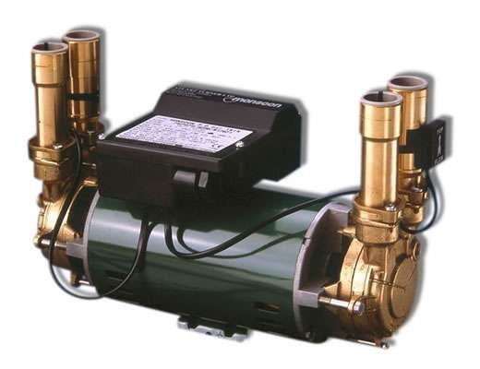
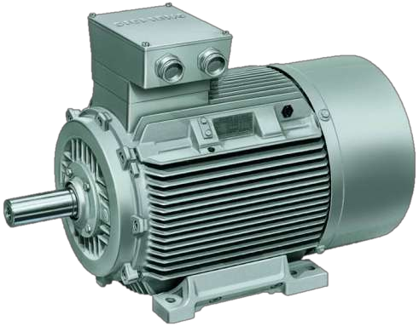
ELECTRICAL MOTORS

Slide 27
Chapter no-04
Understand the importance of Plumbing System
1.Define Plumbing System
2.List the requirements of plumbing installation
3.Identify with sketches the various Plumbing Fittings and Fixtures.
4.Describe the uses of various plumbing fittings and fixtures.
5.List the tools required for plumbing works.
6. Mention the uses and maintenance of various plumbing tools

Slide 28
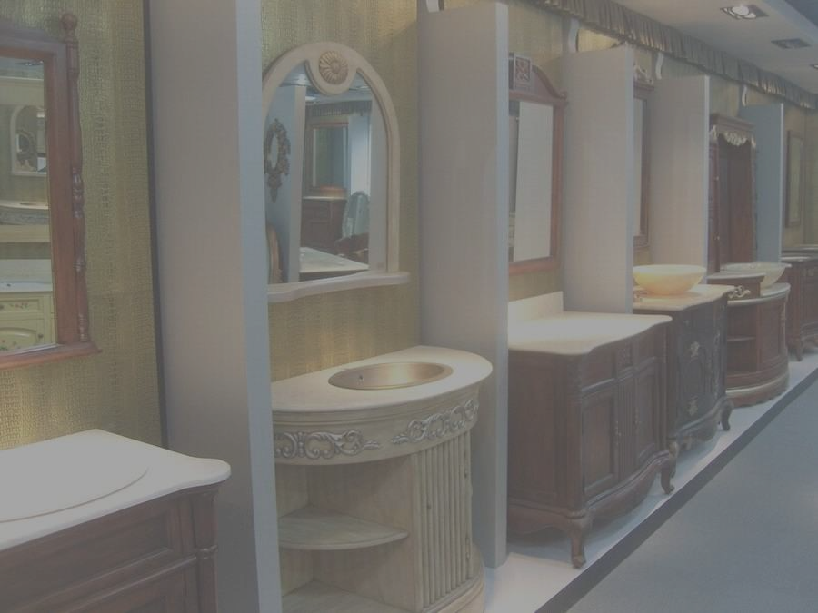



Slide 29
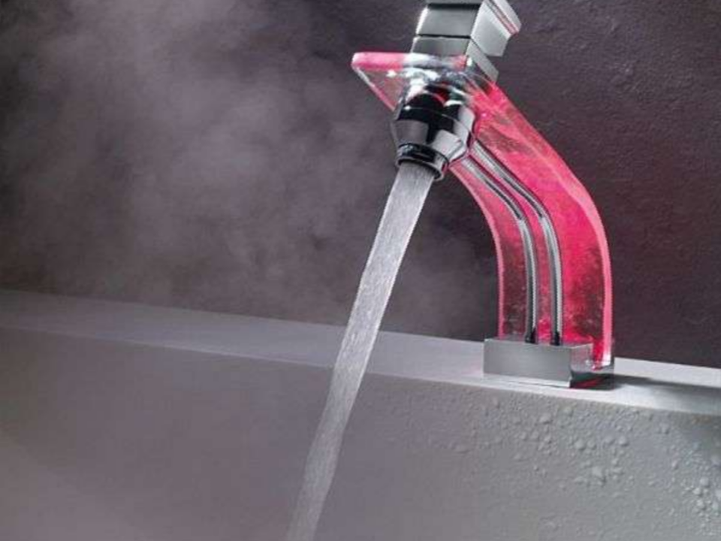
TYPES OF FITTINGS

Slide 30
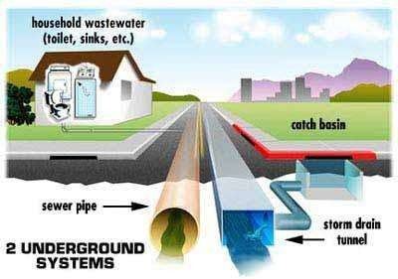
SANITARY SYSTEM

Slide 31
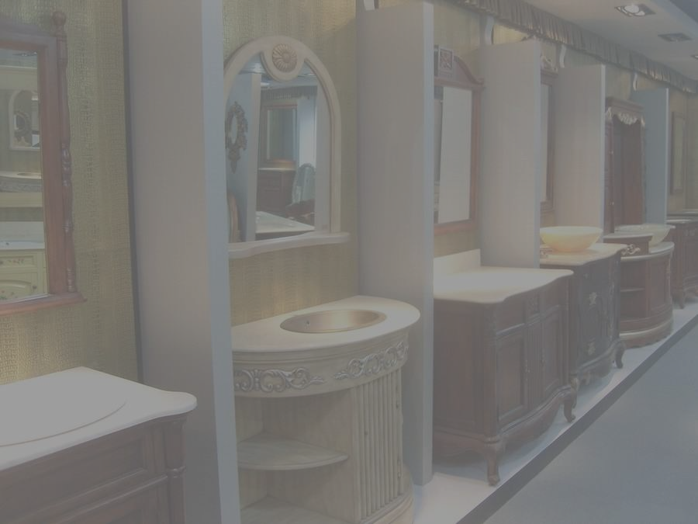
INTRODUCTION
It is the arrangement provided in a house or building for collecting or conveying waste water through drain pipes, by gravity, to join either a public sewer or a domestic septic tank is termed as house drainage or building drainage.

Slide 32

SANITARY SYSTEM

Slide 33

AIMS OF HOUSE DRAINAGE
To maintain healthy conditions in the building
To dispose off waste water as early and quickly as
possible
To avoid the entry of foul gases from the sewer or the septic tank
To facilitate quick removal of foul matter
To collect and remove waste matters systematically

Slide 34


SANITARY SYSTEM

Slide 35
PIPES
Material | Application | Jointing
Cast iron | 50 mm and above vent and discharge stacks | Lead caulking with molten or fibrous lead; cold compound caulking
Galvanised steel | Waste pipe | Screwed
Copper | Waste pipes and traps | Compression, capillary, silver solder, bronze weld or push-fit rings seal
Lead | Waste pipes and discharge stacks | Soldered or lead welded
ABS (acrylonitrile butadiene styrene) | Up to 50 mm waste and vent pipes | Solvent cement and push-fit ring seal
High-density polyethylene | Up to 50 mm waste and ventilating pipes and traps | Push-fit ring seal and compression fittings
Polypropylene | Up to 50 mm waste and ventilating pipes and traps | Push-fit ring seal and compression couplings
Modified PVC | Up to 50 mm waste and vent pipes | Solvent cement and push-fit ring seal
Unplasticized PVC | Over 50 mm soil and vent stacks; vent pipes under 50 mm | Solvent cement and push-fit ring seal
Pitch fibre | Over 50 mm discharge and vent stacks | Driven taper or polypropylene fitting with a push-fit ring seal

Slide 36


PIPES
Soil pipe: A soil pipe is a pipe Through which human excreta flows.
Water Pipe: it is a pipe which carries only the liquid waste. It does not carry human excreta.
Vent pipe; it is a pipe which is provided for the purpose of the ventilation of the system. A vent is open at top and bottom, to facilitate exit of foul gases. It is carried at least one meter higher than the roof level.
Rain water pipe: it is a pipe which carries only the rain water.
Anti-siphonage pipe: it is pipe which is installed in the house drainage
to preserve the water seal of traps.

Slide 37

SIZES OF PIPES
Soil pipe:
Waste pipe: horizontal:
Waste pipe: vertical :
Rainwater pipe :
Vent pipe:
Anti siphoange pipe:
Connecting soil pipe:
Connecting waste pipe:
100mm 30-50mm
75mm 75mm 50mm
50mm 40mm

Slide 38

TRAPS
A trap is depressed or bent fitting that, when provided in a drainage system, always remains full of water, thus maintaining water seal. It prevents the passage of foul air or gas through it, though it allows the sewage or waste water to flow through it. The depth of water seal is the vertical distance between the crown and dip of a trap. The depth of water seal represents its strength or effectiveness. Greater the depth of water seal more effective is the trap. The depth of water seal varies from 25mm to 75mm.

Slide 39
TYPES OF TRAPS
ACCORDING TO SHAPE:
‘P’ TRAP
‘Q’ TRAP
‘S’ TRAP ACCORDING TO USE:
FLOOR TRAP
GULLY TRAP
INTERCEPTING TRAPS
GREASE TRAPS

Slide 40




TRAPS ACCORDING TO SHAPE

Slide 41










TRAPS
EXAM
PLES
‘P’ TRAP
‘S’ TRAP

Slide 42

SANITARY FITTINGS
WASH BASINS
SINKS
BATH TUBS
WATER CLOSETS
URINALS
FLUSHING CISTERNS

Slide 43





BATH TUBS

Slide 44




WASH BASINS

Slide 45






WASH BASINS

Slide 46



SINK
S

Slide 47





URINALS
GENTS TOILETS
STREET URINALS
LADIES TOILETS
PUBLIC TOILETS

Slide 48



WATER CLOSETS & CISTERNS
EUROPEAN

Slide 49



WATER CLOSETS
INDIAN
ANGLO-INDIAN

Slide 50
Chapter No-05
Understand the water supply system with specific reference to Rural & City in Bangladesh
1. Give instruction to alternative technologies in problem areas of Bangladesh :
Shallow shrouded Tube well ,very Shallow shrouded Tube Well,Pond sand filter,Infiltration galleries,Iron Removal unit and deep set technologies.

Slide 51

PLUMBING SYSTEMS
SINGLE STACK SYSTEM
FULLY VENTILATED STACK SYSTEM
ONE PIPE SYSTEM
DUAL PIPE SYSTEM
MODIFIED SINGLE PIPE SYSTEM

Slide 52

ONE PIPE SYSTEM
In the system all soil and waste water discharge into one common pipe and all branch ventilating pipes into one main ventilating pipe. This system largely replaces the two pipe system and lent itself very well to use in multi storey developments. It is far more economical than the two pipe system.

Slide 53

TWO PIPE SYSTEM
The waste stack received the discharge ablutionary fitments and conveyed this to the ground level where it was delivered above the water seal in a trapped gully connected to the drainage system.
the soil stack receives the discharge from soil appliances and delivered it direct to the underground drainage system. The waste and soil water did not combine until they reached the below ground drainage system.

Slide 54

THE FULLY VENTILATED ONE-PIPE SYSTEM
A large number of sanitary appliances in ranges.
Each trap with an anti- siphon or vent pipe connected to the discharge pipe in direction of the flow of water at a point between 75 - 450 mm from trap crown.
Vent stack connected to the discharge stack near to the bend to remove compressed air at this point

Slide 55

The single stack system Reduces the cost of soil and waste systems.
Branch vent pipes are not required
To prevent loss of trap water seals:-
The trap water seals on the waste traps must be 76 mm deep.
The slopes of the branch pipes are: sink and bath, 18 to 19 mm/m; basin 20-120 mm/m; WC 18 mm/m (min.).
Vertical stack at 200 mm below the centre of the WC branch connection.

Slide 56

Modified single stack system
Close grouping of the sanitary appliances → install the branch waste and soil pipes without the need for individual branch ventilating pipes.
To prevent the loss of trap water seals
→ WC branch pipe min. 100 mm
bore and the angle θ = 90.5° to 95°.
To prevent the loss of trap water seals
→ basin main waste pipe min. 50 mm bore and the angle θ = 91° to 92.5°.
Five basins or more / length of the main waste pipe exceeds 4.5 m → a 25 mm bore vent pipe connected to main waste pipe at a point between

Slide 57


