Slide 1
Electrical Properties of Materials
EEE-1203
Band Theory Of Solids
Ref Book: S O Kasap

Slide 2
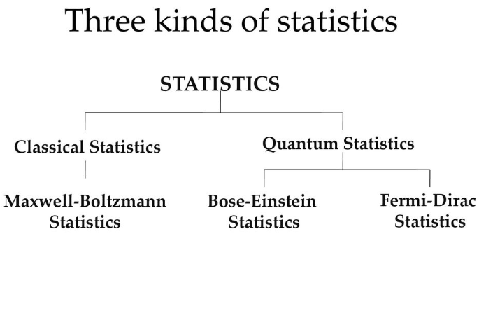

Slide 3
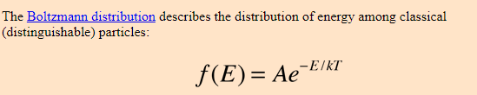
Maxwell-Boltzmann Statistics
What is It ??
In statistical mechanics, Maxwell–Boltzmann statistics describes the distribution of classical material particles over various energy states in thermal equilibrium.
It is applicable when the temperature is high enough or the particle density is low enough to keep quantum effects negligible.

Slide 4
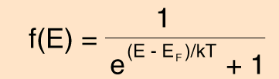
Fermi-Dirac statistics
Fermi-Dirac statistics, in quantum mechanics, a way in which a system of indistinguishable particles can be distributed among a set of energy states: each of the available discrete states can be occupied by only one particle.
The Fermi-Dirac statistics apply only to those types of particles that obey the restriction known as the Pauli exclusion principle.

Slide 5
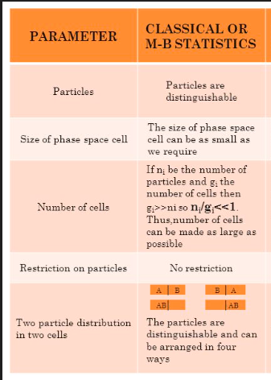
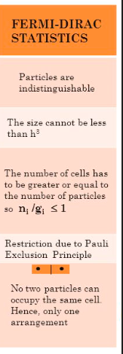
Comparrison Between Two Statistics

Slide 6
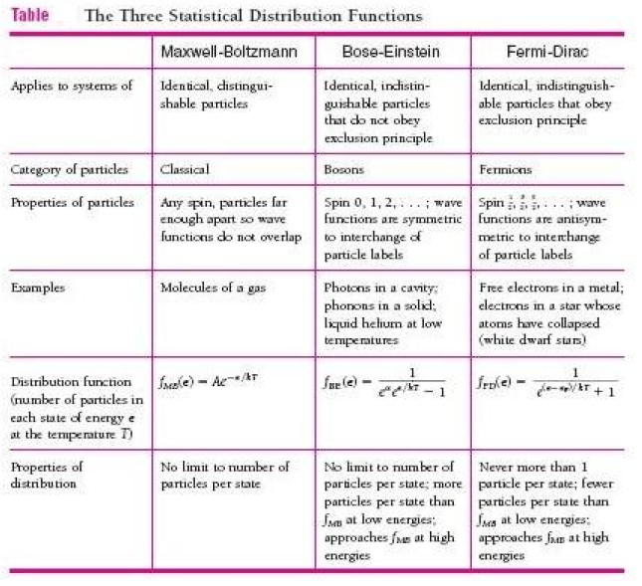

Slide 7
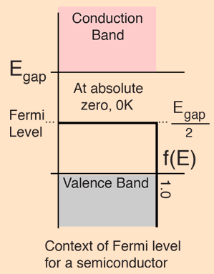
Fermi Level
Fermi level" is the term used to describe the top of the collection of electron energy levels at absolute zero temperature.
At absolute zero electrons pack into the lowest available energy states and build up a "Fermi sea" of electron energy states. The Fermi level is the surface of that sea at absolute zero where no electrons will have enough energy to rise above the surface.

Slide 8
Fermi Energies for Metals
The Fermi energy is the maximum energy occupied by an electron at 0K. By the Pauli exclusion principle, we know that the electrons will fill all available energy levels, and the top of that "Fermi sea" of electrons is called the Fermi energy

