Slide 1
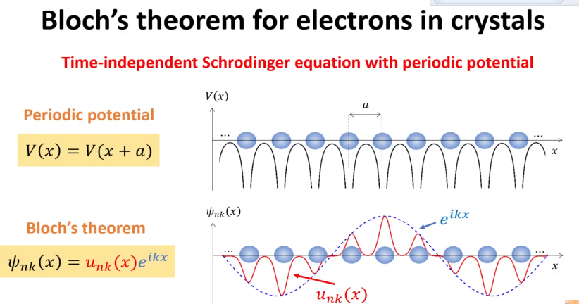

Slide 2
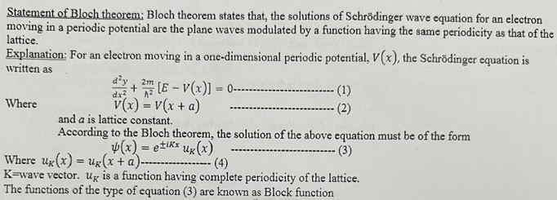

Slide 3
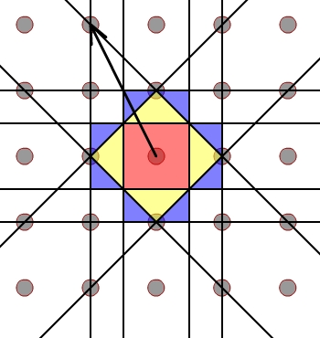
What is Brillounin zones?
Brillounin zone is defined as the set of points close to the origin than any other reciprocal lattice point.
It is classified as first Brillouin zone, second Brillouin zone and third Brillouin zone.

Slide 4
What is the physical significance / importance of a Brillouin zone?
To describe and analyze the electron energy in the band energy structure of crystals
To determine the excitation of photons, phonons and Magnon.

Slide 5
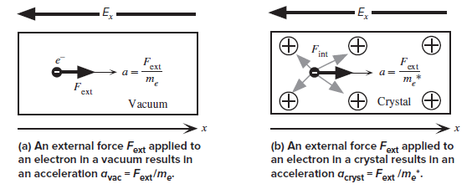
Effective mass of Electron
A Electron effective mass (often denoted m*) is the mass that it seems to have when responding to forces.

Slide 6

The effective mass of electrons is not a fixed value and can vary depending on the specific material and its crystal structure

