Slide 1
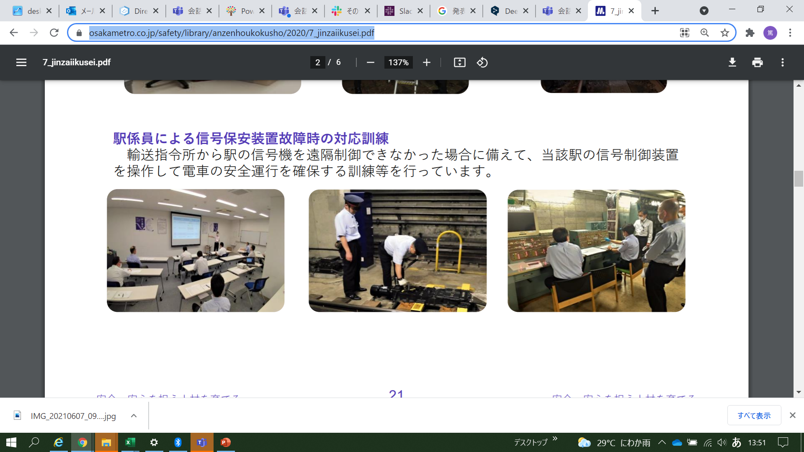
The Project on
Technical Assistance for
MRT Safety Management System on Line 6
Training in Dhaka
4: Introduction of Safety Management System
in Japan
https://www.osakametro.co.jp/safety/library/anzenhoukokusho/2020/7_jinzaiikusei.pdf
Notes:
In this session, we would like to talk about the Introduction of Safety Management System
in Japan.
After introduction of Japanese Safety Management System, we would like to discuss about Safety Management System in DMTCL.

Slide 2
Outline
Background to the Introduction of the Transportation Safety Management System in Japan
Guidelines for Building Japan’s Safety Management System
Summary and Pending Issues
（in case of introduce to DMTCL)
Notes:
Here is an outline of this session.
Background to the Introduction of the Transportation Safety Management System in Japan
Guidelines for Building Japan’s Safety Management System
Summary and Pending Issues in case of introducing Safety Management System to DMTCL

Slide 3
Outline
Purpose and Aims of this Course
Understand Japan’s transportation safety management system
Understand an outline of the approach of the guidelines
Pending issues for considering adaptation for DMTCL and Bangladesh
Notes:
Here is an outline of this session.
Background to the Introduction of the Transportation Safety Management System in Japan
Guidelines for Building Japan’s Safety Management System
Summary and Pending Issues in case of introducing Safety Management System to DMTCL
And Purpose and Aims of this Course​ are,
Understand Japan’s transportation safety management system
Understand an outline of the approach of the guidelines
Pending issues for considering adaptation for DMTCL and Bangladesh

Slide 4
1. Background to the Introduction of the Transportation Safety Management System in Japan
In this chapter, you will learn about the history and background of the introduction of Japan’s transportation safety management system and understand its importance.
Notes:
So we would like to move on to 1st topic.
Background to the Introduction of the Transportation Safety Management System in Japan
In this chapter, you will learn about the history and background of the introduction of Japan’s transportation safety management system
and understand its importance.

Slide 5
1.1 Background to the Introduction of the Transportation Safety Management System
福知山線脱線事故が契機だが、インフラのレベルが上がり、インフラによる事故は減少しているが、それらを扱う人のミス、すなわちヒューマンエラーが増えた。
鉄道輸送のみならず、空港や海運、自動車等のヒューマンエラーも多く発生。
個人のヒューマンエラーを防ぐためには組織としての体制作りが課題で、そのためには国が管理し、体制構築の管理をすべきため。
Consider why Japan decided to introduce a transportation safety management system in 2006,
more than 100 years after rail transportation commenced in Japan in 1872.
Notes:
In Japan, safety management system in 2006, that was just 15 years ago.
That was more than 100 years after rail transportation commenced in Japan in 1872.
So why Japan decided to introduce a transportation safety management system recently?
安全管理体制の構築と継続的改善について
輸送の安全確保は、運輸事業の根幹をなすものであり、
○事業者自らが輸送の安全確保の取組の活性化とレベルアップさせるために必要なことは、
・経営トップ自らがさまざまな取組に対して、主体的かつ積極的に関与するなど強いリーダーシップが必須である。
・また、安全管理体制の取組に対しPDCAサイクルを組み込み継続的に改善していかなければならない。
○また、安全管理体制を構築し改善していくためのなすべきことは、
・運輸安全マネジメント制度の趣旨等を理解し信頼すること
・また、安全管理体制に係る要員への適切な教育・訓練を行うこと
・過剰な文書や記録を排除すること
・さらに、事業規模に相応しい取組を行える体制を確立することが重要である。

Slide 6
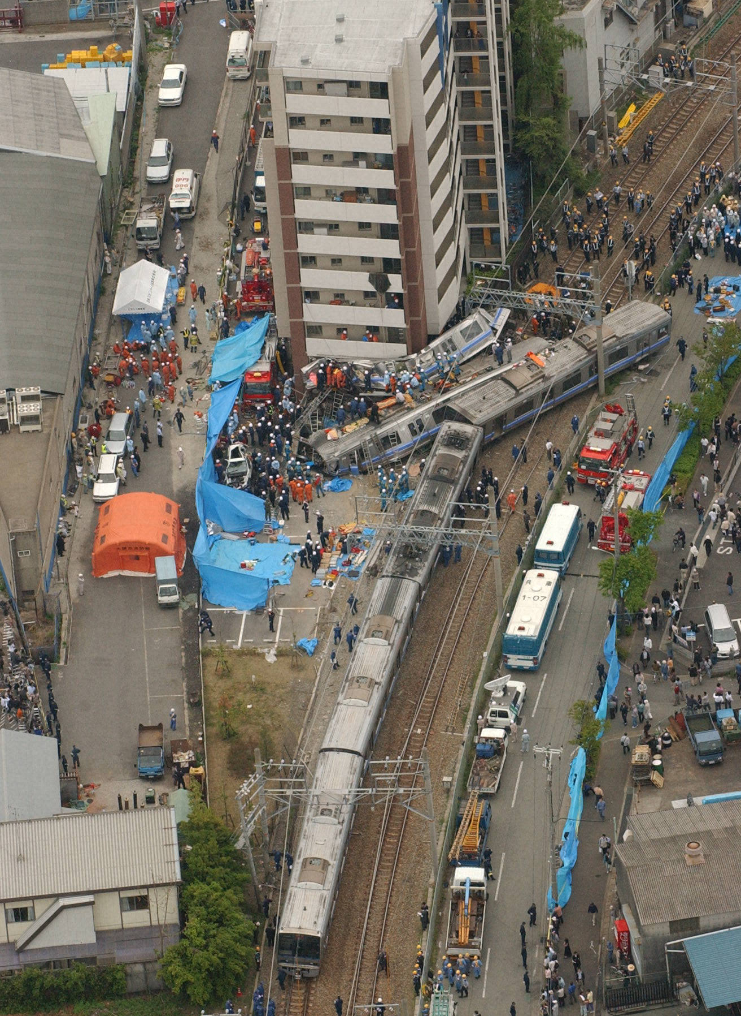
JR West
Fukuchiyama Line Derailment Accident
○ Date
  April 25, 2005
○ Damage
  107 dead
  (including 1 driver), and 562 injured
○ Causes
  Excess speed, inadequate ATS, crew management methods etc.
Notes:
The one of the big epoch to introduce the Transportation Safety Management System was..
JR west Fukuchi-yama line accident we introduced yesterday.
This accident was very big one and the accident shocked Japanese society, because everyone of Japanese believed “Railway is Safety”.
The investigation found that…
The direct causes was excess speed by the driver, however there were many indirect causes such as inadequate ATS, crew management methods etc.
These indirect causes are considered as “Organisational problems for Safety Management”, because of the negative attitude of the railway company’s staff training method and investment for ensuring safety are lead to the serious accident.
さまざまな分野での事故のなかでも、特に先程も紹介した「JR西日本 福知山線」で発生した脱線事故では、
・死者107人、負傷者562人という近年にはない重大事故であった。
・直接の事故原因は、運転士による速度超過とブレーキ操作の遅れであるが、背景要因として、ATS装置の設置遅れや乗務員の管理方法等が大きく関わった可能性があるとの調査結果がなされている。

Slide 7
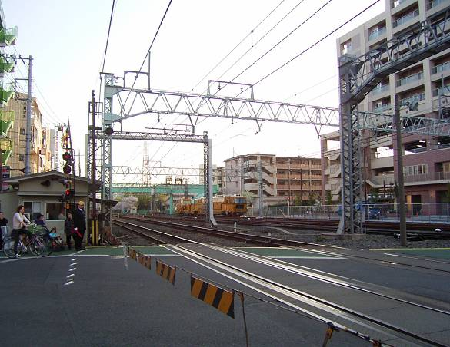
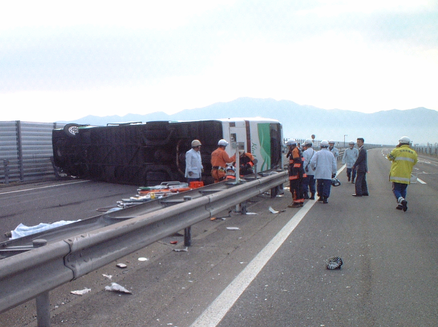
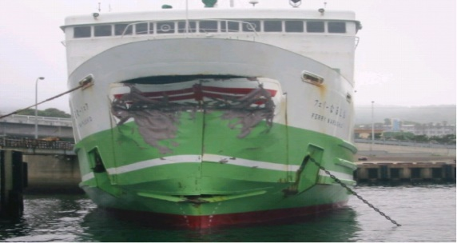
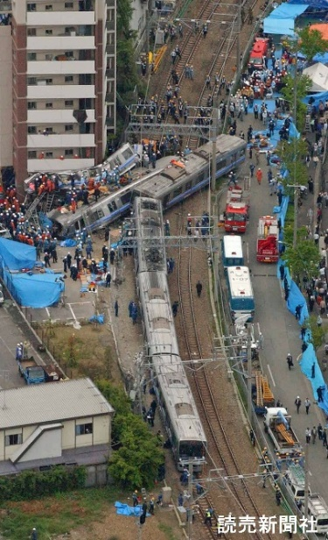
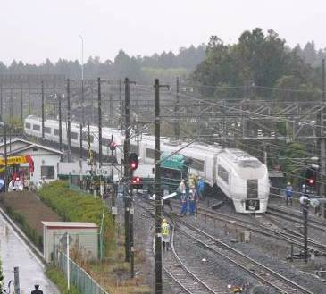
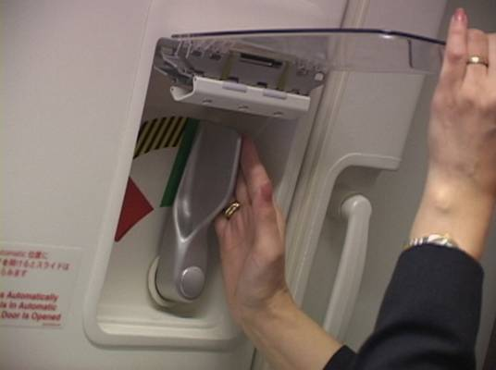
1.3 Transportation Accidents that Triggered the Introduction of the Transportation Safety Management System
●March 2005
Railway
●April 2005
Automobile
●May 2005
Shipping
Level crossing accident
(2 dead, 2 injured)
Bus overturn accident (3 dead, 20 injured)
Ferry breakwater collision (23 injured)
●April 2005
Railway
●April 2005
Automobile
●March 2005
Airline
Train derailment accident (107 dead, 562 injured)
Truck railway crossing collision accident (drunk driving)
Cabin attendant forgot to operate the
emergency exit door
Notes:
In Japan, in 2005, also many accident happened in various transportation sectors caused by “Human Error”
not only railway but also automobile, shipping and Airline, etc like shown in the photos.
In the railway sector, not only Fukuchi-yama line accident I introduced, but also serious railway crossing accident occurred.
In this accident 2 person dead, 2 person injured.
And also you can see
*Bus overturn accident (3 dead, 20 injured)
*Truck railway crossing collision accident
*Ferry breakwater collision (23 injured)
*Cabin attendant forgot to operate the emergency exit door
日本では、2005年に、鉄道・自動車・海運・航空の公共交通の各分野において、ヒューマンエラーが要因と考えられる事故が多発した。
○鉄道分野では、3月に東武鉄道伊勢崎線において、死者2名・負傷者2名の被害があった踏切障害事故、また4月には、「日本における鉄道事故」で紹介した、死者107名、負傷者562名の大惨事となったJR西日本福知山線での列車脱線事故。
○自動車分野では、4月に死者3名、負傷者20名の被害があった近鉄バス転覆事故。
○海運分野では、5月に負傷者23名の被害があった九州商船フェリーなるしおの防波堤衝突事故。
○航空分野においても、3月に重大事故につながる恐れのある、JAL客室乗務員が非常口扉の操作を忘れるなど、
各輸送分野において、ヒューマンエラーに起因するさまざまな事故・トラブルが発生した。
これらの事故・トラブルでは、原因はヒューマンエラーではあるが、共通する背景要因としては、【く】①経営陣の安全確保に対する関与が不十分、②経営・現場間の意思疎通・情報共有が不十分であったなどと調査の結果から考えられている。
7

Slide 8
1.3 Transportation Accidents that Triggered the Introduction of the Transportation Safety Management System
Many accidents and problems caused by human error in the transportation industry in 2005.
The nation had a sense of crisis.
Notes:
Many accidents and problems caused by human error in the transportation industry in 2005 as I have explained in previous slide.
The Japanese Government had a sense of crisis…
8

Slide 9
1.3 Transportation Accidents that Triggered the Introduction of the Transportation Safety Management System
Background factors thought to be common:
Insufficient involvement of management in ensuring safety
Insufficient communication and sharing of information between management and work sites
Notes:
Although the cause of these accidents and troubles was human error,
But the background factors thought to be common
Insufficient involvement of management in ensuring safety
Insufficient communication and sharing of information between management and work sites
the results of the survey suggest that the common background factors were:
(1) Insufficient involvement of management in ensuring safety, and
(2) Insufficient communication and information sharing between management and worksite.
日本では、2005年に、鉄道・自動車・海運・航空の公共交通の各分野において、ヒューマンエラーが要因と考えられる事故が多発した。
○鉄道分野では、3月に東武鉄道伊勢崎線において、死者2名・負傷者2名の被害があった踏切障害事故、また4月には、「日本における鉄道事故」で紹介した、死者107名、負傷者562名の大惨事となったJR西日本福知山線での列車脱線事故。
○自動車分野では、4月に死者3名、負傷者20名の被害があった近鉄バス転覆事故。
○海運分野では、5月に負傷者23名の被害があった九州商船フェリーなるしおの防波堤衝突事故。
○航空分野においても、3月に重大事故につながる恐れのある、JAL客室乗務員が非常口扉の操作を忘れるなど、
各輸送分野において、ヒューマンエラーに起因するさまざまな事故・トラブルが発生した。
これらの事故・トラブルでは、原因はヒューマンエラーではあるが、共通する背景要因としては、【く】①経営陣の安全確保に対する関与が不十分、②経営・現場間の意思疎通・情報共有が不十分であったなどと調査の結果から考えられている。
9

Slide 10
1.3 Transportation Accidents that Triggered the Introduction of the Transportation Safety Management System
The direct causes were human error,
But…
It was identified that behind this was Problems with how organizations interacted with their employees.
Notes:
The direct causes were human error,
but it was identified that behind this was problems with how organizations interacted with their employees.
So the Japanese Government recognized that introduction of “Safety Management System”
by the transportation operators is crucial to for ensuring safety.
the results of the survey suggest that the common background factors were:
(1) Insufficient involvement of management in ensuring safety, and
(2) Insufficient communication and information sharing between management and worksite.
日本では、2005年に、鉄道・自動車・海運・航空の公共交通の各分野において、ヒューマンエラーが要因と考えられる事故が多発した。
○鉄道分野では、3月に東武鉄道伊勢崎線において、死者2名・負傷者2名の被害があった踏切障害事故、また4月には、「日本における鉄道事故」で紹介した、死者107名、負傷者562名の大惨事となったJR西日本福知山線での列車脱線事故。
○自動車分野では、4月に死者3名、負傷者20名の被害があった近鉄バス転覆事故。
○海運分野では、5月に負傷者23名の被害があった九州商船フェリーなるしおの防波堤衝突事故。
○航空分野においても、3月に重大事故につながる恐れのある、JAL客室乗務員が非常口扉の操作を忘れるなど、
各輸送分野において、ヒューマンエラーに起因するさまざまな事故・トラブルが発生した。
これらの事故・トラブルでは、原因はヒューマンエラーではあるが、共通する背景要因としては、【く】①経営陣の安全確保に対する関与が不十分、②経営・現場間の意思疎通・情報共有が不十分であったなどと調査の結果から考えられている。
10

Slide 11
1.4 Introduction of the Transportation Safety Management System
Established a system over a year and a half from the Fukuchiyama Line Accident in April 2005.
The government took the lead in..
Analysing the causes,
Setting laws and regulations,
Establishing a new Secretariat organization …etc.
Notes:
And after the Fukuchi-yama line’s accident in April 2005, the Japanese government hold
“ Public Transport Human Error Accident Prevention Measures Review Committee meeting”,
(Consisting of Administrative Vice-Minister Sponsors and Directors of Related Bureaus etc., private sector experts)
And in the August, the interim report was issued from the Committee , mentioning
Operators need to build a safety management system
National government sees the need to evaluate safety management systems
In the next year, “package of Transport Safety laws” including SMS was promulgated, 運輸安全一括法の公布
And from the October 2006, SMS has started in Japan.
11

Slide 12
1.4 Introduction of the Transportation Safety Management System
April/May | Many transportation accidents due to human error
June 14 | 1st Public Transport Human Error Accident Prevention Measures Review Committee meeting held (Consisting of Administrative Vice-Minister Sponsors and Directors of Related Bureaus etc., private sector experts)
August 4 | Interim Report of the Public Transport Human Error Accident Prevention Measures Review Committee Operators need to build a safety management system National government sees the need to evaluate safety management systems
March 31 | Promulgation of package of Transport Safety laws
From April 1 | Established new secretariat organization
From October 1 | Start of the transportation safety management system
2005
2006
Notes:
And after the Fukuchi-yama line’s accident in April 2005, the Japanese government hold
“ Public Transport Human Error Accident Prevention Measures Review Committee meeting”,
(Consisting of Administrative Vice-Minister Sponsors and Directors of Related Bureaus etc., private sector experts)
And in the August, the interim report was issued from the Committee , mentioning
Operators need to build a safety management system
National government sees the need to evaluate safety management systems
In the next year, “package of Transport Safety laws” including SMS was promulgated, 運輸安全一括法の公布
And from the October 2006, SMS has started in Japan.
12

Slide 13
1.5 Overview of the Transportation Safety Management System
Transport operators are required to continue operation in accordance with guidelines.
National Govt.
Enactment of Transport Safety Law Package
Obligations
Establishment of guidelines. Evaluation of the efforts of transport operators.
MLIT
Recommendation and evaluation of initiatives
Transport Operators
(Manager)
Act in line with safety policy etc. which is issued from top manager.
Initiative management
Transport Operators
(each department)
Understand the activities of guidelines
Notes:
In Japan, Transport operators are required to continue operation in accordance with guidelines.
Whole structure of implementation of SMS in Japan is shown in this figure.
The national government enacted the transportation safety law,
and in the law, implementation of SMS by each transportation operators are mandatory.
And MLIT Japan, Ministry of Land, Infrastructure, Transport and Tourism has established the guideline for SMS.
And also MLIT has role of making comments or evaluation of each transportation operator’s activity​ based on the guideline.
And the each transport operators, to conduct SMS in the company, the top manager issues their company’s “Safety Policy”
and each department of the operators act in line to the “Safety Policy”
13

Slide 14
2. Guidelines for Building Japan’s Safety Management System
In this chapter, you will learn the underlying meaning behind the guidelines for building Japan’s safety management system and understand the important details.
Notes:
So we would like to move on to 2nd topic.
Guidelines for Building Japan’s Safety Management System
In this chapter, you will learn the underlying meaning behind the guidelines for building Japan’s safety management system
and understand the important details.

Slide 15
2.1 Positioning and Purposes of
Guidelines
Guidelines must be worked out by transportation operators.
Positioning
  Sets out reference examples of the aims and procedure for initiatives related to the construction and improvement of safety management systems
  Do not deny voluntary and proactive efforts by methods other than those set out in guidelines
Notes:
Firstly I’d like to explain about “Positioning and Purposes of Guidelines”, that guideline is established by MLIT Japan.
Each transportation operators conduct SMS following the guideline.
And for the positioning of the guideline are;
*The guideline sets out reference examples of the aims and procedure for initiatives related to the construction and improvement of SMS
ガイドラインにおいては、事業者における安全管理体制の構築・改善に係る取組のねらいとその進め方の参考例が示されています。
*however, the guideline does not deny the transport operator’s voluntary and proactive efforts which is not shown in the guideline.
And for the main purposes of the guideline are;
1)”Autonomous and continuous realization” and “review/improvement” of appropriate SMS by each operators
適切な安全管理体制の自律的・継続的な実現と見直し・改善
2)”Provide persistent motivation for the thorough sharing and realization of compliance with laws and regulations” and “the principle of safety first with all employees of operators”
関係法令等の遵守と安全最優先の原則の事業者内部の全要員への徹底及び実現のための不断の動機付け
3)Build and establish a safety culture within operators
ガイドラインの位置付けと目的であるが、
○位置付けとしては、事業者における安全管理体制の構築・改善に係る取組のねらいとその進め方の参考例を示すものである。
○ただし、ガイドラインに示す取組以外の方法であっても、事業者として最も良いと考えられる方法により積極的に進めることは否定しない。とされている。
○またガイドラインの目的は、
①適切な安全管理体制の自律的・継続的な実現と見直しと改善
②関係法令等の遵守と安全最優先の原則の事業者内部の全要員への徹底及び実現のための不断の動機付け
③これらによって、事業者内部の安全文化を構築させ、定着させること
以上の3点がガイドラインの大きな目的とされている。
15

Slide 16
2.1 Positioning and Purposes of
Guidelines
Guidelines must be worked out by transportation operators.
Purposes
  Autonomous and continuous realization and review/improvement of appropriate safety management systems
  Provide persistent motivation for the thorough sharing and realization of compliance with laws and regulations and the principle of safety first with all employees of operators
  Build and establish a safety culture within operators
Notes:
Firstly I’d like to explain about “Positioning and Purposes of Guidelines”, that guideline is established by MLIT Japan.
Each transportation operators conduct SMS following the guideline.
And for the positioning of the guideline are;
*The guideline sets out reference examples of the aims and procedure for initiatives related to the construction and improvement of SMS
ガイドラインにおいては、事業者における安全管理体制の構築・改善に係る取組のねらいとその進め方の参考例が示されています。
*however, the guideline does not deny the transport operator’s voluntary and proactive efforts which is not shown in the guideline.
And for the main purposes of the guideline are;
1)”Autonomous and continuous realization” and “review/improvement” of appropriate SMS by each operators
適切な安全管理体制の自律的・継続的な実現と見直し・改善
2)”Provide persistent motivation for the thorough sharing and realization of compliance with laws and regulations” and “the principle of safety first with all employees of operators”
関係法令等の遵守と安全最優先の原則の事業者内部の全要員への徹底及び実現のための不断の動機付け
3)Build and establish a safety culture within operators
ガイドラインの位置付けと目的であるが、
○位置付けとしては、事業者における安全管理体制の構築・改善に係る取組のねらいとその進め方の参考例を示すものである。
○ただし、ガイドラインに示す取組以外の方法であっても、事業者として最も良いと考えられる方法により積極的に進めることは否定しない。とされている。
○またガイドラインの目的は、
①適切な安全管理体制の自律的・継続的な実現と見直しと改善
②関係法令等の遵守と安全最優先の原則の事業者内部の全要員への徹底及び実現のための不断の動機付け
③これらによって、事業者内部の安全文化を構築させ、定着させること
以上の3点がガイドラインの大きな目的とされている。
16

Slide 17
2.2 “14 Examples” of Guidelines
There are 14 safety management initiatives that are expected of transportation operators,
which they need to work on at autonomously.
Notes:
And in the Guideline, there are 14 safety management initiatives, that are expected to transportation operators to work on autonomously.
(1) Obligations of top management
(2) Safety policy
(3) Priority safety measures
(4) Responsibilities of safety supervisors
(5) Responsibilities and authority of personnel
(6) Information sharing and ensuring communication
(7) Collection and utilization of accident and near-miss information etc.
(8) Response to serious accidents etc.
(9) Ensure compliance with relevant laws and regulations
(10) Necessary education and training for the construction and improvement of the safety management system
(11) Internal audits
(12) Management review and continuous improvement
(13) Creation and management of documentation
(14) Creation and maintenance of records
これは、運輸事業者における安全管理の進め方に関するガイドライン(平成22年3月)に示されている、運輸事業者に期待される14項目の安全管理に係る取組である。
①経営トップの責務
②安全方針
③安全重点施策
④安全統括管理者の責務
⑤要員の責任・権限
⑥情報伝達及びコミュニケーションの確保
⑦事故、ヒヤリハット情報等の収集・活用
⑧重大な事故等への対応
⑨関係法令等の遵守の確保
⑩安全管理体制の構築・改善に必要な教育・訓練等
⑪内部監査
⑫マネジメントレビューと継続的改善
⑬文書の作成及び管理
⑭記録の作成及び維持
17

Slide 18
2.2 “14 Examples” of Guidelines
(1) Obligations of top management
(2) Safety policy
(3) Priority safety measures
(4) Responsibilities of safety supervisors
(5) Responsibilities and authority of personnel
(6) Information sharing and ensuring communication
(7) Collection and utilization of accident and near-miss information etc.
(8) Response to serious accidents etc.
(9) Ensure compliance with relevant laws and regulations
(10) Necessary education and training for the construction and improvement of the safety management system
(11) Internal audits
(12) Management review and continuous improvement
(13) Creation and management of documentation
(14) Creation and maintenance of records
Notes:
And in the Guideline, there are 14 safety management initiatives, that are expected to transportation operators to work on autonomously.
(1) Obligations of top management
(2) Safety policy
(3) Priority safety measures
(4) Responsibilities of safety supervisors
(5) Responsibilities and authority of personnel
(6) Information sharing and ensuring communication
(7) Collection and utilization of accident and near-miss information etc.
(8) Response to serious accidents etc.
(9) Ensure compliance with relevant laws and regulations
(10) Necessary education and training for the construction and improvement of the safety management system
(11) Internal audits
(12) Management review and continuous improvement
(13) Creation and management of documentation
(14) Creation and maintenance of records
これは、運輸事業者における安全管理の進め方に関するガイドライン(平成22年3月)に示されている、運輸事業者に期待される14項目の安全管理に係る取組である。
①経営トップの責務
②安全方針
③安全重点施策
④安全統括管理者の責務
⑤要員の責任・権限
⑥情報伝達及びコミュニケーションの確保
⑦事故、ヒヤリハット情報等の収集・活用
⑧重大な事故等への対応
⑨関係法令等の遵守の確保
⑩安全管理体制の構築・改善に必要な教育・訓練等
⑪内部監査
⑫マネジメントレビューと継続的改善
⑬文書の作成及び管理
⑭記録の作成及び維持
18

Slide 19




2.2 “14 Examples” of Guidelines
The measures follow “PDCA cycle”, and not be omitted.
Obligations of
top management
Top management proactively and actively involved in safety management system, demonstrating leadership
Ensure Safety
Respon-sibility
President
All employees execute together
Formulate Policy
(4) Responsibilities of safety supervisors
(6) Information sharing and
ensuring communication
Transportation Safety
(2) Safety policy
Formulate and disseminate safety policies
(7) Collection and utilization of accident and near-miss information etc.
(5) Responsibilities and authority of personnel
(3) Priority safety measures
(8) Response to serious accidents etc.
P
D
Formulate and disseminate annual safety targets and action plans in line with safety policy
(9) Ensure compliance with
relevant laws and regulations
(10) Necessary education and training for the construction and improvement of the safety management system
(12) Management review and
continuous improvement
A
C
Improvement
(11) Internal audits
Targets
Continuously implement corrective and preventive measures for issues in the safety management system identified by reviews etc.
Conduct autonomous in-house checks of the construction and operating status of internal safety management systems at least once a year (and as needed in the case of serious accidents etc.)
Transport checks at least once a year
(13) Creation and management of documentation
(14) Creation and maintenance of records
Notes:
And the fourteen measures should be implemented in PDCA cycle and each measures are related each-other
And none of the measure can be omitted, as shown in this figure.
Firstly, (1)Obligations of top management is important.
Top manager should demonstrate leadership and proactively and actively involved in safety management system.
And for P “Plan”,
(2) Safety Policy is formulated by the managers to set out the basis of the company's approach to safety,
and each department formulates its own (3) Priority Safety Measures in line with this policy.
And for D “Do”,
(4) Responsibilities of safety supervisors in relation to various safety activities;
(5) Responsibilities and authority of personnel as those who directly implement activities;
(6) Information sharing and ensuring communication, which is necessary for smooth implementation of activities as an organization;
(7) Collection and utilization of accident and near-miss information, which is key to ensuring safety;
(8) Response to serious accidents; (9) Ensure compliance with relevant laws and regulations, which is necessary for ensuring safety; and
(10) Necessary education and training for the construction and improvement of the SMS
..are methods to be conducted.
And for A “Act”,
(12) Management review and continuous improvement shall be carried out in order to take corrective and preventive measures in response to issues identified by the internal audit,
and shall lead to the next P "Plan".
(13) Creation and management of documentation, sets out the procedures for carrying out activities, and
(14) Creation and maintenance of records, is an important effort to clarify the actual activities.
In addition, the documents and records are an important basis for conducting internal audits.
For each of these 14 items, it is necessary to spiral up repeatedly based on the PDCA cycle.
And this figure shows the fourteen measures to
この図は、ガイドラインに示された14項目の取組をPDCAサイクルに当てはめたものである。
まず、経営トップのリーダーシップをもとに、
P(計画)：安全への取組みの基本を示す「②安全方針」、また各部門ではそれに沿って「③安全重点施策」を策定する。
D(実行)：安全へのさまざまな活動に係る「④安全統括管理者の責務」、活動を直接実施する者としての「⑤要員の責任と権限」、組織として取組をスムーズに進めるために必要な「⑥情報伝達及びコミュニケーションの確保」、安全を確保していく上でキーとなる「⑦事故、ヒヤリ・ハット情報等の収集・活用」、また万一の「⑧重大な事故等が発生した際の対応」、安全を確保する上で必要な「⑨関係法令等の遵守の確保」及び「⑩安全管理体制の構築・改善に必要な教育・訓練等」が実行すべき項目となる。
C(評価)：「⑪内部監査」は、これらの活動状況を確認・評価し、アドバイスするために重要な項目となる。
A(改善)：また、内部監査で見いだされた課題等に対する、是正・予防措置を図るための「⑫マネジメントレビューと継続的改善」を実施し、次のPにつなげなければならない。
「⑬文書の作成と改定を含む適切な管理」は、活動を行うための手順等を定めたものであり、「⑭記録の作成及び維持」については、実際に活動したことを明確にするための重要な取組である。
また文書、記録については、内部監査を実施する上での重要な根拠となる。
なお、これらの14項目の、それぞれ一つひとつに対してもPDCAサイクルに基づき、繰り返しスパイラルアップすることが求められる。
では、次にこれらの項目に従い、みなさんが輸送の安全を確保するためにどのようなことをすべきかについての基本的なことを説明していく。
各項目の詳細は、それぞれのグループに応じた必要事項について、グループ別研修において説明する。
19

Slide 20
2.2 “14 Examples” of Guidelines
【Discussion 1】 (3)Priority Safety Measures
Please consider what of “Priority Safety Measures” in DMTCL
(Example of Osaka Metro)
1)Commitment from Top Manager:
- Building a culture that prioritises safety
- Prevention of human error and troubles
- Dissemination of safety information …etc
2)Action plan
- Monthly "accident sprout" meetings
- Publish examples of preventable accidents as
"safety actions" within the department.
- Disseminate information about accidents at other companies
…etc

Slide 21
2.2 “14 Examples” of Guidelines
【Discussion 2】
Please consider what actions you can take in
(6) Information sharing
and ensuring communication
(7) Collection and utilization of accident
and near-miss information
Please imagine if you are the director of each sector
Ex. Reporting of abnormal condition of Track, Braking, etc

Slide 22
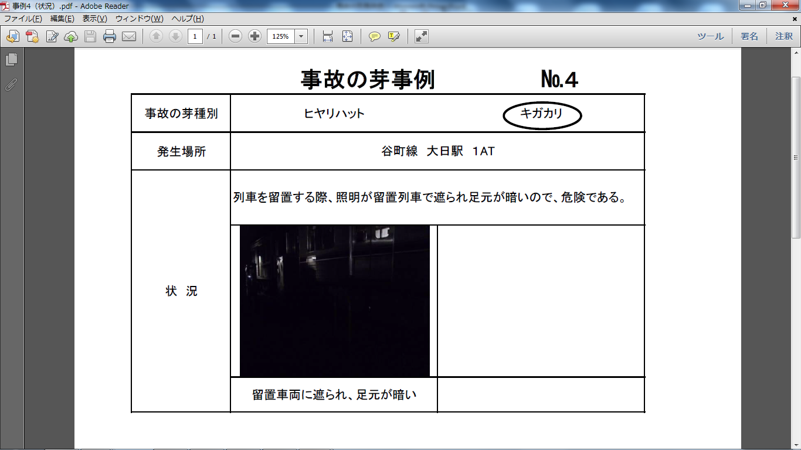
Examples of Osaka Metro for “(6) Information sharing and ensuring communication”
“Accident Sprout" Report Form
Type
Worries Near-miss
Place
Tanimachi Line, Dainichi St, AT1
There are dark areas on the track in the shadow of the train.
Condition

Slide 23
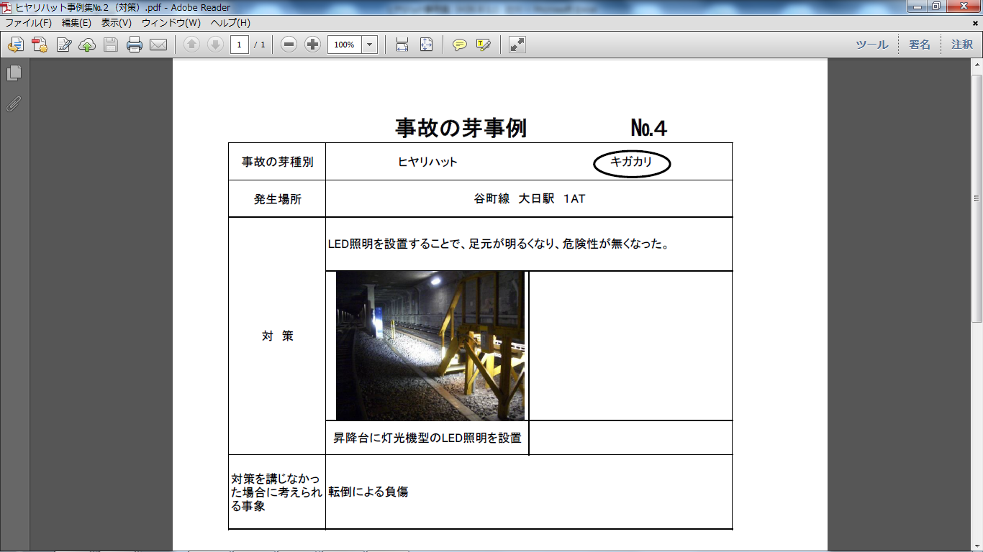
“Accident Sprout" Report Form
Type
Worries Near-miss
Place
Tanimachi Line, Dainichi St, AT1
The installation of LED lighting has eliminated the darkness and made it safer to work.
Counter
measures
Possible
Risk
Falls and injuries in the dark

Slide 24
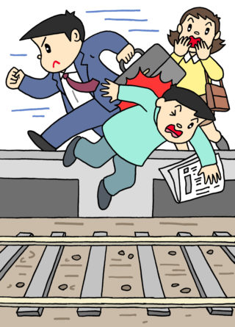
2.2 “14 Examples” of Guidelines
【Discussion 3】
(8) Response to serious
accidents
If you have found the possibility of serious accident.
What will you do in terms of “Safety First Principle”?
Please imagine the scene and your action.
Ex. Passengers fell/dive to the track, etc

Slide 25
3. Summary and Pending Issues
Summary of this training. Also includes future issues, as this course only introduces the Japanese system.
Notes:
So we would like to move on Summary and Pending Issues.
Summary of this training.
Also includes future issues, as this course only introduces the Japanese system.
So it is important how to introduce SMS to DMTCL.

Slide 26
3.1 Summary
In Japan, while the system was promoted at the initiative of the national government, each operator works on their own initiatives with a high level of safety awareness.
This mechanism is the basis of transportation safety.
Notes:
In Japan, while the system was promoted at the initiative of the national government,
each operator works on their own initiatives with a high level of safety awareness.
This mechanism is the basis of transportation safety.
鉄道の安全の歴史は、過去に発生した多くの運転事故を活かすことで安全性を高めてきた。
しかし、これまでの経験を活かしきれないだけでなく安全に対する考え方を根底から覆すような重大事故が発生していることも事実である。
我々は鉄道従事者として、安全の原点に立ち返り、過去の事故から得られた貴重な教訓を無駄にすることなく、安全・安心を追求し続けなければならない。
鉄道事業者としての生命は「安全の確保」である。過去の事故を知り、運転の基本的なルールを会得し、事故の未然防止に努めること、また不幸にして事故が発生したときには、お客さまの救護を最優先に行動しなければならないことを事業者はもとより鉄道従事員一人ひとりが肝に命じなければならない。

Slide 27
3.1 Summary
What is the background of the introduction of the transportation safety management system?
What action has the national government taken?
What actions are required of operators?
What actions are required of workers?
Notes:
In Japan, while the system was promoted at the initiative of the national government,
each operator works on their own initiatives with a high level of safety awareness.
This mechanism is the basis of transportation safety.
So I’d like to ask you following questions;
What is the background of the introduction of the transportation safety management system?
What action has the national government taken?
What actions are required of operators?
What actions are required of workers?
For these questions, I’d like to explain our Japanese experience on the railway operator's mission once again.
In the history of railway safety, We have improved safety by learning the many driving accidents that have occurred in the past.
However, unfortunately, we are still facing for serious accident that is not familiar with our experience, even if the technology and facilities are developed.
Therefore, as railway workers, we must return to the basics of safety and continue to pursue safety and security, without wasting the valuable lessons learned from past accidents.
Our vital mission as a railway operator is “Ensuring Safety”.
Every railway worker, as well as every operator, must be aware of..
Past accidents, learn the basic rules of driving, and strive to prevent accidents from occurring,
and if accident occurred unfortunately, we should act for saving the lives of customers in the top priority.
鉄道の安全の歴史は、過去に発生した多くの運転事故を活かすことで安全性を高めてきた。
しかし、これまでの経験を活かしきれないだけでなく安全に対する考え方を根底から覆すような重大事故が発生していることも事実である。
我々は鉄道従事者として、安全の原点に立ち返り、過去の事故から得られた貴重な教訓を無駄にすることなく、安全・安心を追求し続けなければならない。
鉄道事業者としての生命は「安全の確保」である。過去の事故を知り、運転の基本的なルールを会得し、事故の未然防止に努めること、また不幸にして事故が発生したときには、お客さまの救護を最優先に行動しなければならないことを事業者はもとより鉄道従事員一人ひとりが肝に命じなければならない。

Slide 28
3.2 Pending Issues for DMTCL
Consider the challenges for the introduction of a transportation safety management system to transport operators in Bangladesh.
Notes:
And to develop SMS in DMTCL, we should consider and discuss following issues;
Consider the challenges for the introduction of a transportation SMS to transport operators in Bangladesh.【Discussion】
(ex) a) Who should lead the SMS in the central government? In Bangladesh the ministries are separated as
Ministry of Railway, Ministry of Road Transport Bridge, Ministry of Civil Aviation and Tourism, Ministry of Shipping
b) Can the ministry lead the SMS or Can the ministry evaluate of monitor each operator’s activity?
c) Does the company staff follow the SMS lead by the company’s managers?
Also consider your own opinions regarding measures to address these challenges. 【Discussion】
(ex) a) DMTCL develops their own SMS. b)developing SMS cooperation with BR
c) getting support from Japan on SMS evaluation
d) Cross-ministerial SMS efforts
3. Consider the possibility of adapting the 14 examples of initiatives from Japan for introducing a safety management system by DMTCL.
Also list any possible initiatives other than these 14. 【Discussion】
4. In Future, Consider how DMTCL supports the introduction of safety management system to BR, if BR would like to introduce SMS seeing DMTCL’s advanced initiatives.
安全管理体制の構築と継続的改善について
輸送の安全確保は、運輸事業の根幹をなすものであり、
○事業者自らが輸送の安全確保の取組の活性化とレベルアップさせるために必要なことは、
・経営トップ自らがさまざまな取組に対して、主体的かつ積極的に関与するなど強いリーダーシップが必須である。
・また、安全管理体制の取組に対しPDCAサイクルを組み込み継続的に改善していかなければならない。
○また、安全管理体制を構築し改善していくためのなすべきことは、
・運輸安全マネジメント制度の趣旨等を理解し信頼すること
・また、安全管理体制に係る要員への適切な教育・訓練を行うこと
・過剰な文書や記録を排除すること
・さらに、事業規模に相応しい取組を行える体制を確立することが重要である。

Slide 29
3.2 Pending Issues for DMTCL
Consider the challenges for the introduction of a transportation safety management system to transport operators in Bangladesh.
(ex) a) Who should lead the SMS in the central government?
In Bangladesh the ministries are separated as …
* Ministry of Railway
* Ministry of Road Transport Bridge
* Ministry of Civil Aviation and Tourism
* Ministry of Shipping
b) Can the ministry lead the SMS or
Can the ministry evaluate of monitor each operator’s
activity?
c) Does the company staff follow the SMS lead by
the company’s managers?
Notes:
And to develop SMS in DMTCL, we should consider and discuss following issues;
Consider the challenges for the introduction of a transportation SMS to transport operators in Bangladesh.【Discussion】
(ex) a) Who should lead the SMS in the central government? In Bangladesh the ministries are separated as
Ministry of Railway, Ministry of Road Transport Bridge, Ministry of Civil Aviation and Tourism, Ministry of Shipping
b) Can the ministry lead the SMS or Can the ministry evaluate of monitor each operator’s activity?
c) Does the company staff follow the SMS lead by the company’s managers?
Also consider your own opinions regarding measures to address these challenges. 【Discussion】
(ex) a) DMTCL develops their own SMS. b)developing SMS cooperation with BR
c) getting support from Japan on SMS evaluation
d) Cross-ministerial SMS efforts
3. Consider the possibility of adapting the 14 examples of initiatives from Japan for introducing a safety management system by DMTCL.
Also list any possible initiatives other than these 14. 【Discussion】
4. In Future, Consider how DMTCL supports the introduction of safety management system to BR, if BR would like to introduce SMS seeing DMTCL’s advanced initiatives.
安全管理体制の構築と継続的改善について
輸送の安全確保は、運輸事業の根幹をなすものであり、
○事業者自らが輸送の安全確保の取組の活性化とレベルアップさせるために必要なことは、
・経営トップ自らがさまざまな取組に対して、主体的かつ積極的に関与するなど強いリーダーシップが必須である。
・また、安全管理体制の取組に対しPDCAサイクルを組み込み継続的に改善していかなければならない。
○また、安全管理体制を構築し改善していくためのなすべきことは、
・運輸安全マネジメント制度の趣旨等を理解し信頼すること
・また、安全管理体制に係る要員への適切な教育・訓練を行うこと
・過剰な文書や記録を排除すること
・さらに、事業規模に相応しい取組を行える体制を確立することが重要である。

Slide 30
3.2 Pending Issues for DMTCL
【考えられる課題】
・国が主導できるか。
・事業者が自主的に取り組めるか
・社員が従うか
・国が事業者を評価できるか
・監督省庁が異なる。
DMTCL/道路全般→Ministry of Road Transport Bridge
BR→Ministry of Railway
空港→Ministry of Civil Aviation and Tourism
港湾→Ministry of Shipping
【考えられる対応策】
・評価業務について日本の支援を得る
・国としての制度ではなくDMTCL内で取り組む
・省庁横断組織を作る
運輸業界全体ではBRとの協働可能性を問いたい。
2. Consider your own opinions regarding
measures to address these challenges.
Notes:
And to develop SMS in DMTCL, we should consider and discuss following issues;
Consider the challenges for the introduction of a transportation SMS to transport operators in Bangladesh.【Discussion】
(ex) a) Who should lead the SMS in the central government? In Bangladesh the ministries are separated as
Ministry of Railway, Ministry of Road Transport Bridge, Ministry of Civil Aviation and Tourism, Ministry of Shipping
b) Can the ministry lead the SMS or Can the ministry evaluate of monitor each operator’s activity?
c) Does the company staff follow the SMS lead by the company’s managers?
Also consider your own opinions regarding measures to address these challenges. 【Discussion】
(ex) a) DMTCL develops their own SMS. b)developing SMS cooperation with BR
c) getting support from Japan on SMS evaluation
d) Cross-ministerial SMS efforts
3. Consider the possibility of adapting the 14 examples of initiatives from Japan for introducing a safety management system by DMTCL.
Also list any possible initiatives other than these 14. 【Discussion】
4. In Future, Consider how DMTCL supports the introduction of safety management system to BR, if BR would like to introduce SMS seeing DMTCL’s advanced initiatives.
安全管理体制の構築と継続的改善について
輸送の安全確保は、運輸事業の根幹をなすものであり、
○事業者自らが輸送の安全確保の取組の活性化とレベルアップさせるために必要なことは、
・経営トップ自らがさまざまな取組に対して、主体的かつ積極的に関与するなど強いリーダーシップが必須である。
・また、安全管理体制の取組に対しPDCAサイクルを組み込み継続的に改善していかなければならない。
○また、安全管理体制を構築し改善していくためのなすべきことは、
・運輸安全マネジメント制度の趣旨等を理解し信頼すること
・また、安全管理体制に係る要員への適切な教育・訓練を行うこと
・過剰な文書や記録を排除すること
・さらに、事業規模に相応しい取組を行える体制を確立することが重要である。

Slide 31
3.2 Pending Issues for DMTCL
【考えられる課題】
・国が主導できるか。
・事業者が自主的に取り組めるか
・社員が従うか
・国が事業者を評価できるか
・監督省庁が異なる。
DMTCL/道路全般→Ministry of Road Transport Bridge
BR→Ministry of Railway
空港→Ministry of Civil Aviation and Tourism
港湾→Ministry of Shipping
【考えられる対応策】
・評価業務について日本の支援を得る
・国としての制度ではなくDMTCL内で取り組む
・省庁横断組織を作る
運輸業界全体ではBRとの協働可能性を問いたい。
2. Consider your own opinions regarding
measures to address these challenges.
(ex) a) DMTCL develops their own SMS.
b) developing SMS cooperation with BR
c) getting support from Japan on SMS evaluation
d) Cross-ministerial SMS efforts
Notes:
And to develop SMS in DMTCL, we should consider and discuss following issues;
Consider the challenges for the introduction of a transportation SMS to transport operators in Bangladesh.【Discussion】
(ex) a) Who should lead the SMS in the central government? In Bangladesh the ministries are separated as
Ministry of Railway, Ministry of Road Transport Bridge, Ministry of Civil Aviation and Tourism, Ministry of Shipping
b) Can the ministry lead the SMS or Can the ministry evaluate of monitor each operator’s activity?
c) Does the company staff follow the SMS lead by the company’s managers?
Also consider your own opinions regarding measures to address these challenges. 【Discussion】
(ex) a) DMTCL develops their own SMS. b)developing SMS cooperation with BR
c) getting support from Japan on SMS evaluation
d) Cross-ministerial SMS efforts
3. Consider the possibility of adapting the 14 examples of initiatives from Japan for introducing a safety management system by DMTCL.
Also list any possible initiatives other than these 14. 【Discussion】
4. In Future, Consider how DMTCL supports the introduction of safety management system to BR, if BR would like to introduce SMS seeing DMTCL’s advanced initiatives.
安全管理体制の構築と継続的改善について
輸送の安全確保は、運輸事業の根幹をなすものであり、
○事業者自らが輸送の安全確保の取組の活性化とレベルアップさせるために必要なことは、
・経営トップ自らがさまざまな取組に対して、主体的かつ積極的に関与するなど強いリーダーシップが必須である。
・また、安全管理体制の取組に対しPDCAサイクルを組み込み継続的に改善していかなければならない。
○また、安全管理体制を構築し改善していくためのなすべきことは、
・運輸安全マネジメント制度の趣旨等を理解し信頼すること
・また、安全管理体制に係る要員への適切な教育・訓練を行うこと
・過剰な文書や記録を排除すること
・さらに、事業規模に相応しい取組を行える体制を確立することが重要である。

Slide 32
3.2 Pending Issues for DMTCL
【考えられる課題】
・国が主導できるか。
・事業者が自主的に取り組めるか
・社員が従うか
・国が事業者を評価できるか
・監督省庁が異なる。
DMTCL/道路全般→Ministry of Road Transport Bridge
BR→Ministry of Railway
空港→Ministry of Civil Aviation and Tourism
港湾→Ministry of Shipping
【考えられる対応策】
・評価業務について日本の支援を得る
・国としての制度ではなくDMTCL内で取り組む
・省庁横断組織を作る
運輸業界全体ではBRとの協働可能性を問いたい。
3. Consider the possibility of adapting the 14 examples of initiatives from Japan for introducing a safety management system by DMTCL. Also list any possible initiatives other than these
4. Consider how DMTCL supports the introduction of safety management system to BR if BR introduces in future.
Notes:
And to develop SMS in DMTCL, we should consider and discuss following issues;
Consider the challenges for the introduction of a transportation SMS to transport operators in Bangladesh.【Discussion】
(ex) a) Who should lead the SMS in the central government? In Bangladesh the ministries are separated as
Ministry of Railway, Ministry of Road Transport Bridge, Ministry of Civil Aviation and Tourism, Ministry of Shipping
b) Can the ministry lead the SMS or Can the ministry evaluate of monitor each operator’s activity?
c) Does the company staff follow the SMS lead by the company’s managers?
Also consider your own opinions regarding measures to address these challenges. 【Discussion】
(ex) a) DMTCL develops their own SMS. b)developing SMS cooperation with BR
c) getting support from Japan on SMS evaluation
d) Cross-ministerial SMS efforts
3. Consider the possibility of adapting the 14 examples of initiatives from Japan for introducing a safety management system by DMTCL.
Also list any possible initiatives other than these 14. 【Discussion】
4. In Future, Consider how DMTCL supports the introduction of safety management system to BR, if BR would like to introduce SMS seeing DMTCL’s advanced initiatives.
安全管理体制の構築と継続的改善について
輸送の安全確保は、運輸事業の根幹をなすものであり、
○事業者自らが輸送の安全確保の取組の活性化とレベルアップさせるために必要なことは、
・経営トップ自らがさまざまな取組に対して、主体的かつ積極的に関与するなど強いリーダーシップが必須である。
・また、安全管理体制の取組に対しPDCAサイクルを組み込み継続的に改善していかなければならない。
○また、安全管理体制を構築し改善していくためのなすべきことは、
・運輸安全マネジメント制度の趣旨等を理解し信頼すること
・また、安全管理体制に係る要員への適切な教育・訓練を行うこと
・過剰な文書や記録を排除すること
・さらに、事業規模に相応しい取組を行える体制を確立することが重要である。

Slide 33
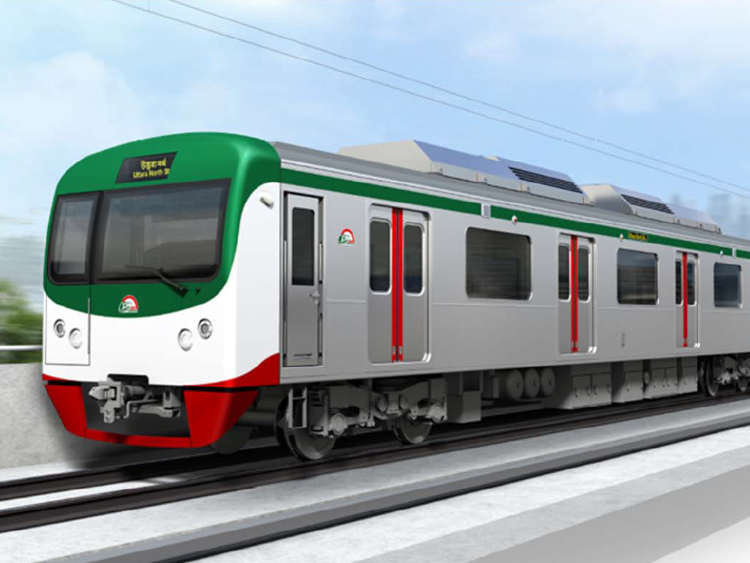
Thank you very much for your kind attention
আপনাদের সবাইকে ধন্যবাদ

