Slide 1

Presenting Mobile Application, “Drug Admin” for reporting counterfeit medicine detection overpricing & ADR reporting.
Directorate General of Drug Administration

Slide 2
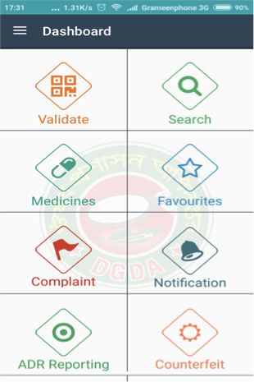

Mobile Application:
“Drug Admin”
With the help of the honorable Prime Minister’s office’s A2i project, our Drug Administration is working towards building the mobile app which will enable us to make rightly priced, proper quality, safe and effective medicine available to the door steps of the mass people.
Google Play Store represents,
Four key features of this application:
Identifying counterfeited drug
Complain about over pricing of drugs
Complain about medicine
Adverse Drug Reaction Reporting

Slide 3
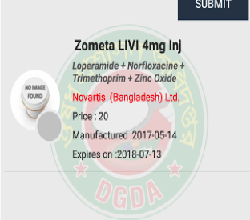
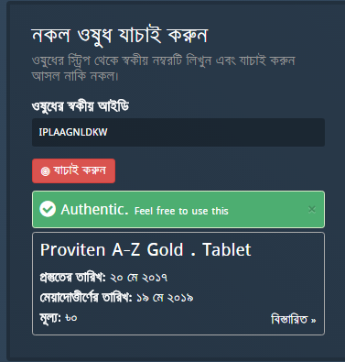
Mobile Push-Pool SMS
1. (CODE TO 16541)/
2. WRITE : DGDA (11 CHARACTER CODE ) Send : 333

Slide 5
Medicine Authentication System
11 Character Code (Full Alphabetical except Z,I,O)
First Three character will symbolize company name
Rest 8 characters will be generated through random permutation and combination (20c8)
In this way 21,000 crore codes can be generated for a single pharmaceuticals manufacturer.
It will be officially launched by September 15, 2018.
On pilot basis, 2 products of the top 5 manufacturers will be selected for the code application

Slide 6
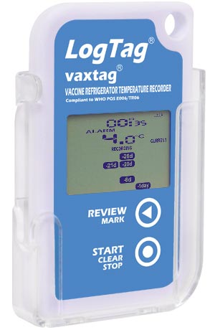
LOGTAG
Certified compliant to WHO PQS specification E006/TR06.3.
Real time clock records time & temperature simultaneously.
Display shows current state (READY, STARTING, RECORDING or PAUSED).
Battery state shown on display.
ALARM indicator appears on the display to show an alarm trigger has occurred.
Displays alarm triggers in calendar-like format for up to the last 30 days.
Shows the current time and temperature when not in review mode.
Allows review of current day and up to 29 previous days of statistical data and also
Price around 6,000 BDT + 3 years maintenance 600 BDT
Stores up to the last 7770 time stamped temperature data for later download.
WHO-GBT requirement for GDP
RI - 4.3/ML3C
155 (279)

Slide 7
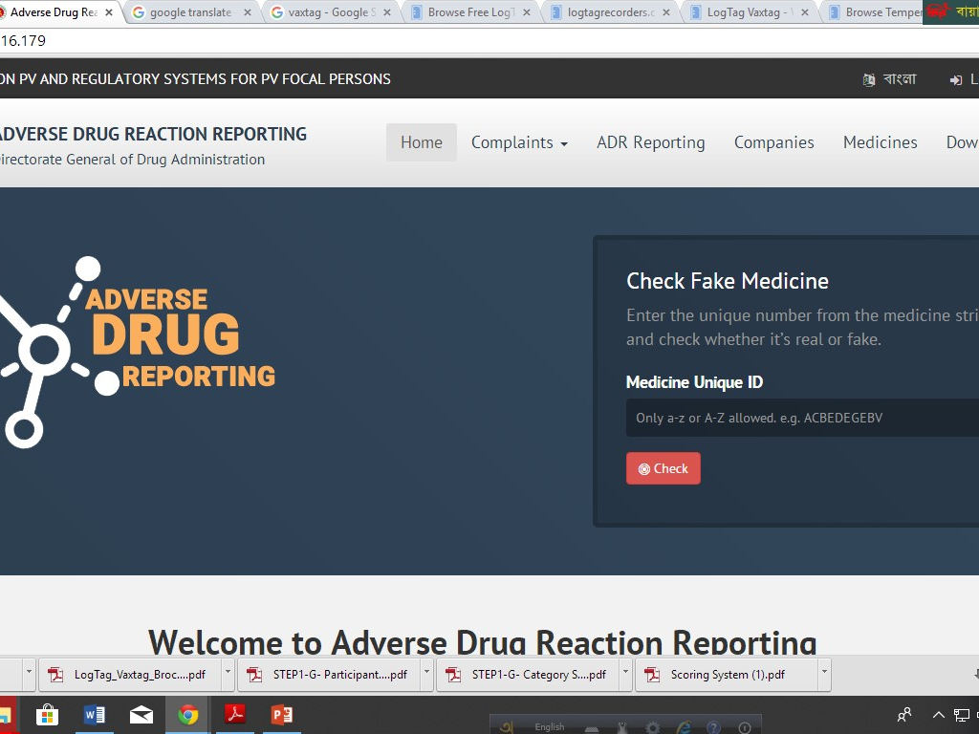

Slide 8
